Slide 1
KS2 SATs Parent Information
2026

Slide 2
What are the Key Stage 2 tests?
Children in Year 6 will be taking the Key Stage 2 Tests in May 2026. They provide information about how your child is progressing and how they compare to children of the same age nationally. They provide a ‘snapshot’ of your child’s learning, progress and attainment at the end of KS2. These tests are both set and marked externally.
The tests are not qualifications and don’t affect your child’s future options in school. However, they do help to develop key skills which provide an important foundation for secondary school.

Slide 3

What strategies have been in place to help support your child?
Assessments used throughout the year to identify gaps and learning planned around these.
Carefully chosen whole class reading texts
Maths taught allowing for smaller class sizes.
Intervention groups throughout the year.
Focused Grammar teaching.
Mock SATs week – familiarisation

Slide 4
When do they take place?
Date | Paper | Time
Monday 11th May | English Grammar, Punctuation and Spelling (GPS) Paper 1 | 45 minutes
Monday 11th May | English Grammar, Punctuation and Spelling (GPS) Paper 2 | Approximately 15 minutes
Tuesday 12th May | English Reading | 1 hour
Wednesday 13th May | Mathematics Paper 1: Arithmetic | 30 minutes
Wednesday 13th May | Mathematics Paper 2: Reasoning | 40 minutes
Thursday 14th May | Mathematics Paper 3: Reasoning | 40 minutes

Slide 5
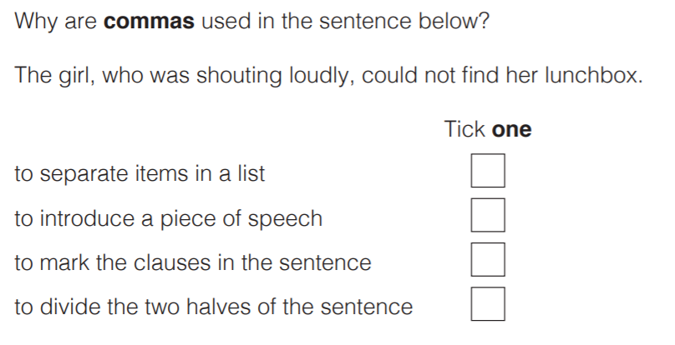
What is involved in the GPS tests?
The GPS Test
Paper 1 assesses grammar and punctuation (50 marks)
Paper 2 assesses spelling (20 words)
A variety of question types
We can read questions out if children ask in Paper 1

Slide 6
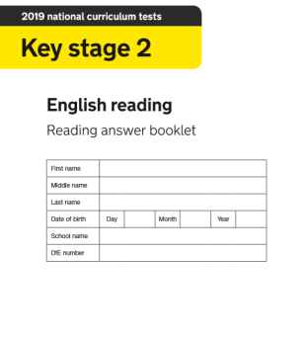
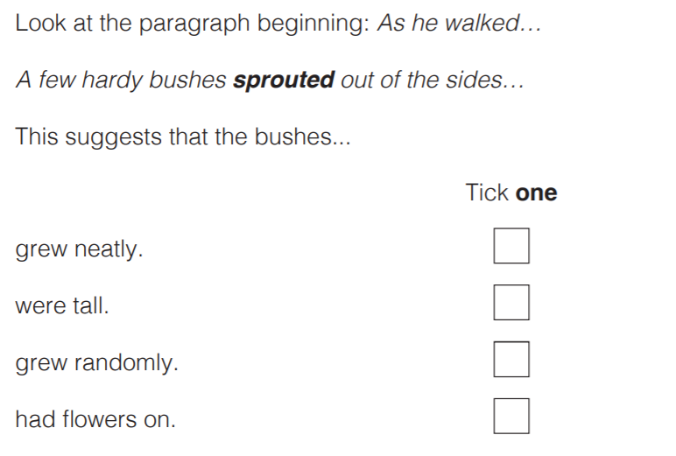
What is involved in the Reading tests?
The Reading Test
Three passages of text which get progressively more difficult
A total of 50 marks
A variety of question types

Slide 7
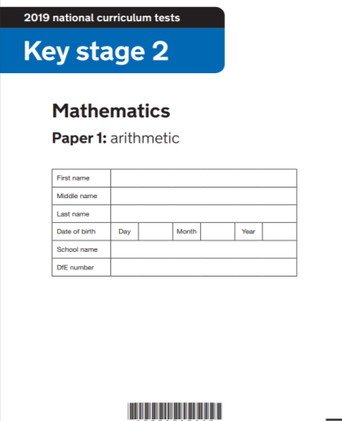
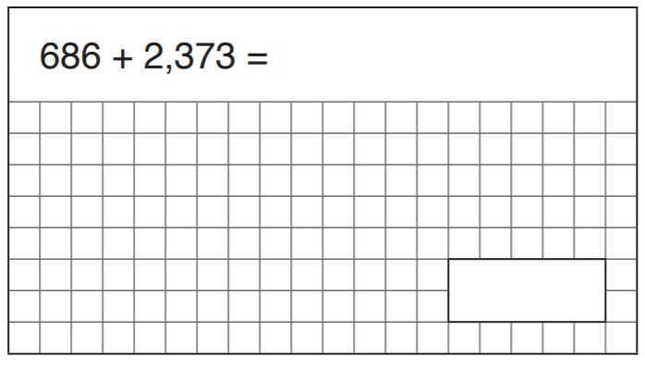
What is involved in the Maths tests?
3 Papers in total
The Arithmetic Test – Paper 1
35 questions
No context to the questions, so there is no reading needed
Some can be solved mentally, others require jottings or written methods
Long multiplication and long division are worth 2 marks (all other questions are worth 1 mark)

Slide 8
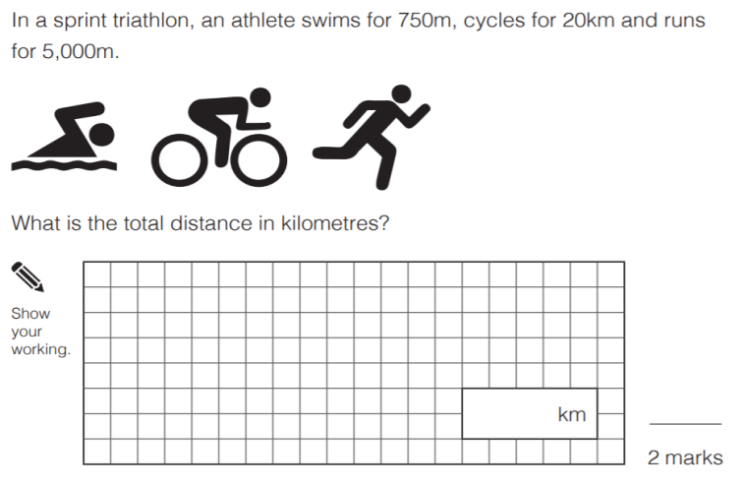
Maths Paper 2 and 3
The Reasoning Tests
35 marks per paper
They assess mathematical problem solving and reasoning
Calculators not allowed
A significant amount of reading needed
We can read the questions to the children if they ask.

Slide 9
Access Arrangements
Scribes | Application not required Evidence of it being normal classroom practice | Rest Breaks | Approval not required Must reflect normal classroom practice
Readers | No prior approval or notification required Must reflect normal classroom practice (evidence of this may be required) Must be on a one-to-one basis In most cases for children with low reading age Schools should ensure that readers have the necessary training on the tests and their role as readers | Prompters | Approval not required Can be used to support a pupil who is unable to focus independently or who loses attention easily Must reflect normal classroom practice Must be used on a one-to-one basis
Additional time | Approval required with evidence to support the application Strict criteria

Slide 10
Writing Assessment 2026
No test for writing as teacher assessment is used.
Teachers have already marked lots of assessments this year.
Children are aware of their progress and what they need to do next.
We will continue to teach and assess writing until June, when assessments have to be submitted to the DFE.
Final assessment levels and all results will be reported to parents before the end of term.

Slide 11
How are the results reported to parents?
Once the tests have been externally marked, the school will receive the results. Your child will be allocated a raw score (the number of marks they achieved in the test) and a scaled score. A scaled score of 100 represents the expected standard of the test. The range of scaled scores available are 80 (the lowest scaled score) and 120 (the highest scaled score). To recognise higher attainment in the KS2 tests, a higher standard grade may be awarded. The table below shows the raw scores needed to reach both standards in 2019. However, please note the number of marks needed to meet expected and higher standard changes each year.
 | Raw score for expected standard | Raw score for higher standard
Reading | 28 | 40
GPS | 35 | 54
Maths | 58 | 95

Slide 12
Final Note
It is important to understand that to receive a score for a subject, all the papers for that subject must be taken.
If your child is very ill during this period please contact school at the start of the day, if you feel they could attempt the paper they can come in to school complete the test, then leave school.
Having early nights and a good breakfast will give your child the best start to the day.
Please provide your child with a water bottle that they can have on their desk during the tests.
We will run a breakfast club during that week to motivate children and give extra time for relaxation and revision.

