Slide 1

Year One
Phonics Screening Check
23rd March 2026

Slide 2

What is the Phonics Screening Check
The phonics screening check is a national assessment completed by all children at the end of Year One.
This year the check will take place in the week commencing Monday 8th June 2026.
The aim of the check is to ensure that all children are on track with their reading so that all children leave Year Two able to read fluently.
The phonics screening check only assesses children’s ability to decode.

Slide 3


How does the check work?
The check is made up of forty words of increasing difficulty.
20 of the words are decodable, phonetic words.
The other 20 words are ‘alien’ words – they are decodable but do not make any sense.
Alien words are always accompanied by a picture of an alien so that children are clear about which words are alien and which are not.

Slide 4
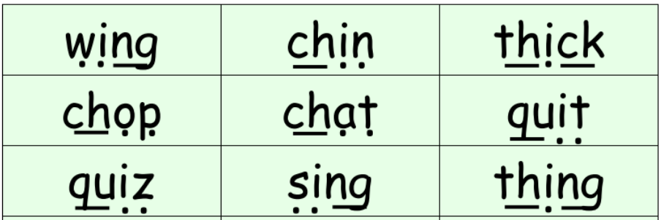
How is the check administered?
The check is very low pressure!
Children are assessed 1:1 by their class teacher in a quiet room.
This is something they are all used to doing – we do small phonics checks regularly throughout the year.
The children will not know they are being ‘tested’.
We will encourage all children to put on their ‘dots and dashes’. This is something they are very used to doing in phonics.

Slide 5
What are we doing to prepare?
All children attend phonics every day for forty-five minutes. This session is based on the children’s ability rather than age, so all children receive targeted support in a small group that meets their needs.
Every day in phonics, children read words containing a variety of sounds.
Every day in phonics, children practice reading alien words.
For children who need it, they are receiving 1:1 phonics support sessions at least three times per week.
Phonics club afterschool ( by invitation only)

Slide 6
Results
The pass mark will not be published until July.
For as long as the check has existed, the pass mark has been 32/40. We assume it will be the same this year, but we cannot guarantee it.
We will share the children’s results with you in their end of year report.
If your child does not achieve 32/40, they will continue to do phonics next year (as will the vast majority of children) and they will have another opportunity to complete the check in Year Two.

Slide 7
What can you do at home?
Read every day!
Ensure your child watch the virtual links from the school website if they require support.
Speak to your child’s class teacher if you need further information.

Slide 8
Online resources available
Ruth Miskin Parents’ Page:
https://www.ruthmiskin.com/parents/
Phonics screening check (Year 1) - Oxford Owl
Free e-books for home reading:
http://www.oxfordowl.co.uk/Reading/

Slide 9
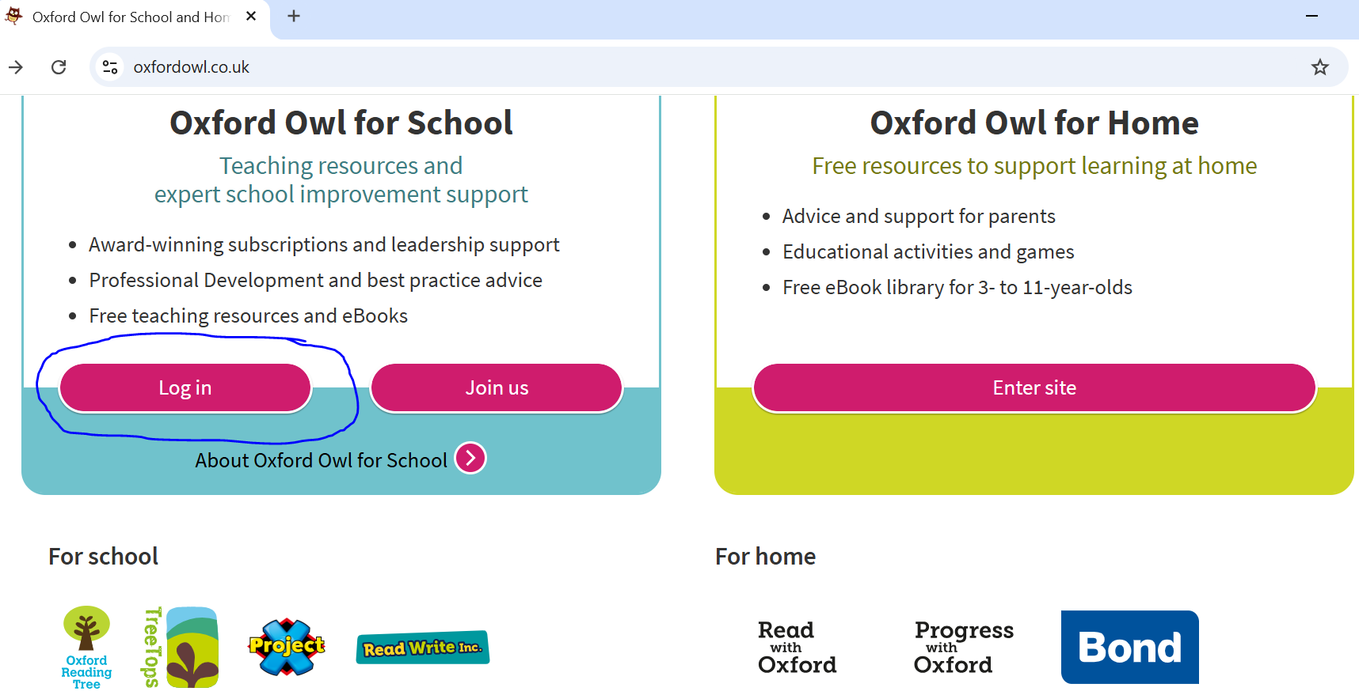
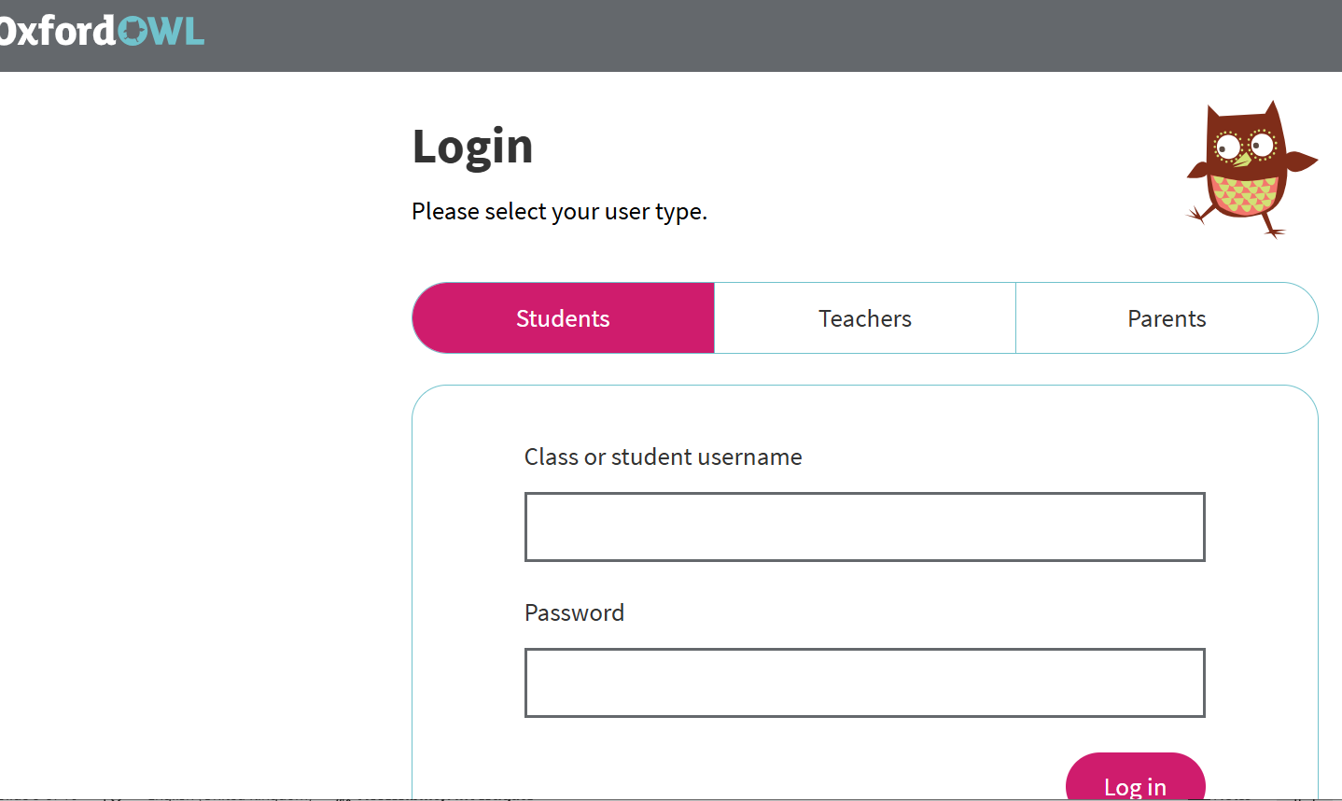
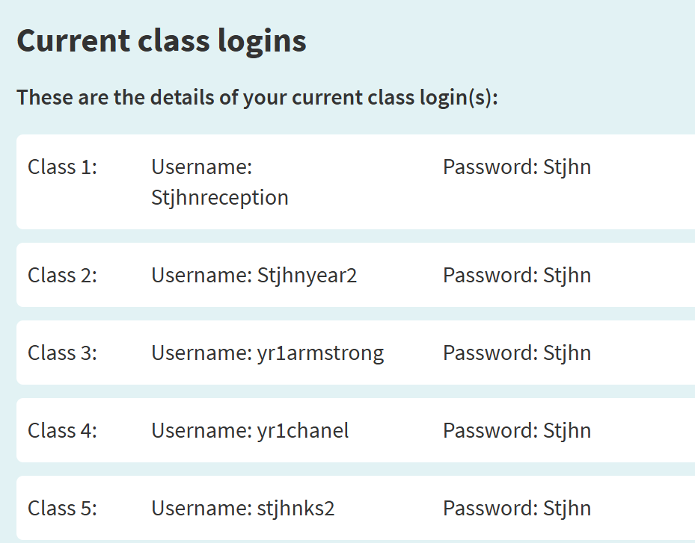
To access RWI eBooks https://www.oxfordowl.co.uk/

Slide 10
Thank you for your time.
Any questions?

