Slide 1

Key Instant Recall Facts
What are KIRFs?
To develop your child’s fluency and mental maths skills, we are introducing KIRFs (Key Instant Recall Facts) throughout the school. KIRFs are a way of helping your child to learn - by heart - key facts and information which they need to have instant recall of.
KIRFs are designed to support the development of mental maths skills that underpin much of the maths work in our school. They are particularly useful when calculating, adding, subtracting, multiplying or dividing. KIRFs contain number facts such as number bonds and times tables that need constant practise and rehearsal so children can recall them quickly and accurately.
Instant recall of facts helps enormously with mental agility in maths lessons. When children move onto written calculations, knowing these key facts is very beneficial as it reduces the cognitive load needed, allowing the children to focus on the higher-level maths. KIRFs are not about challenging the children but making sure ALL children have key mathematical facts at their fingertips.
The secret to success is practising little and often. Can you practise these KIRFs while walking to school or during a car journey? You do not need to practise them all at once; perhaps you could have a fact of the day.

Slide 2
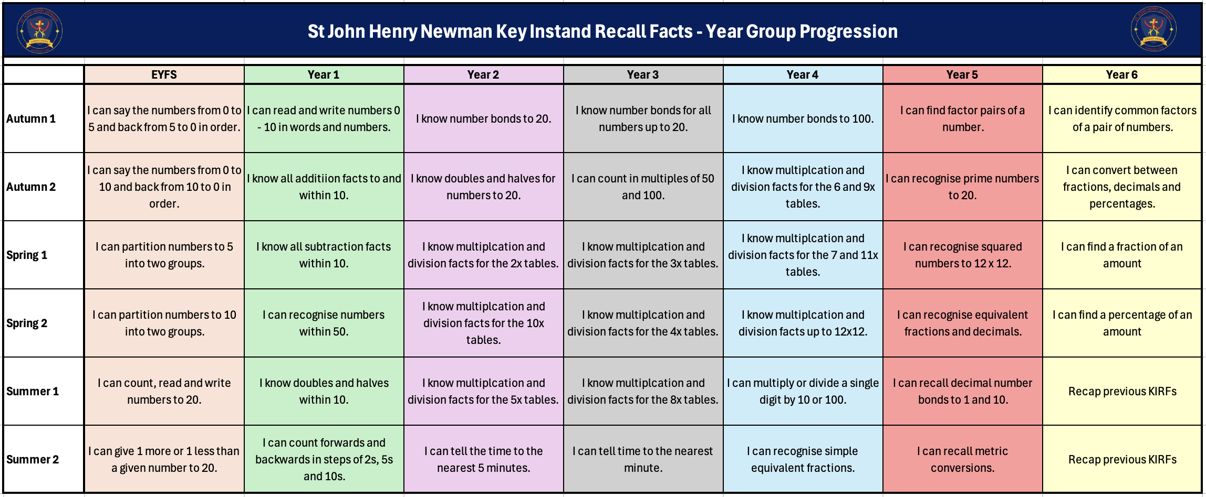
School Overview

Slide 3
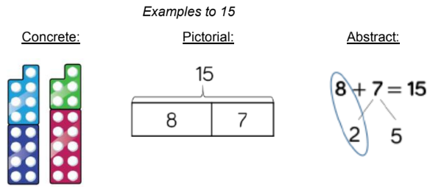

Autumn Term 1 – Year 3
I know the number bonds for all numbers to 20.
The children should know the number bonds for all numbers up to 20
e.g. Number bonds to 16: 0 + 16 = 16, 1 + 15 = 16, 2 + 14 = 16, etc.
Key vocabulary:
2 add 11 equals 13
5 plus 12 is the same as 17
16 take away 7 equals 9
19 subtract 3 makes 16
18 minus 9 equals 9
Activities that can be done at home:
Everyday Objects- gather together objects and separate them in s many different ways as possible, write the calculation to match each one.
Make a poster – we use lots of concrete, pictorial and abstract methods in school. Your child could make a poster on any number 1-20 showing different methods to make the number bonds.
https://www.mathplayground.com/number_bonds_20.html for number bonds on different numbers.

Slide 4
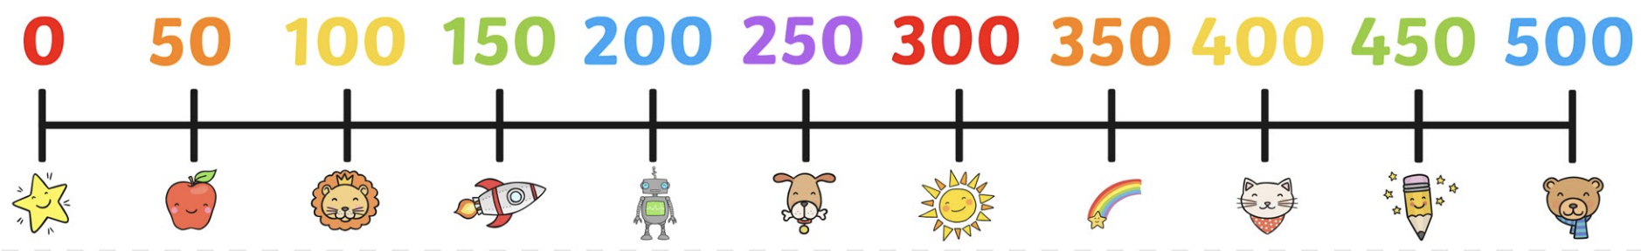
Autumn Term 2 – Year 3
I can count in multiple of 50 and 100.
Key vocabulary:
What is the third multiple of 50?
How many groups of 50 equal 200?
How many 100s makes 1,000?
Children should be able to count accurately and with speed in multiples of 50 and 100.
Activities that can be done at home:
Use what you already know – If your child knows how to count in multiples of 100, they can use this knowledge to count in multiples of 50 as half of 100 equals 50. E.g. 2 x 100 = 200 so 4 x 50 = 200
Chant multiples of 50 or 100 together

Slide 5

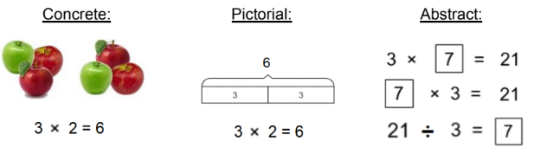
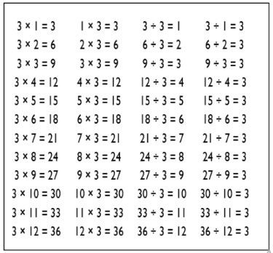
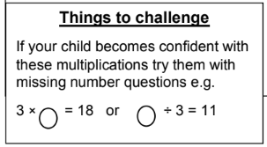
Spring Term 1 – Year 3
I know the multiplication and division facts for the 3 times tables.
A times table is a list of multiples of a given number. They are used in many calculations and having an instant recall of these facts will support the children in many areas of learning.
Key vocabulary:
Multiply
Times
Divide
Shared by
Equals
Activities that can be done at home:
Chants- practice chanting the times table.
Everyday Objects- gather together objects and separate them into groups of 3.
Youtube – there are lots of Times table songs on Youtube to aid learning, why not try one out.
https://ttrockstars.com/

Slide 6
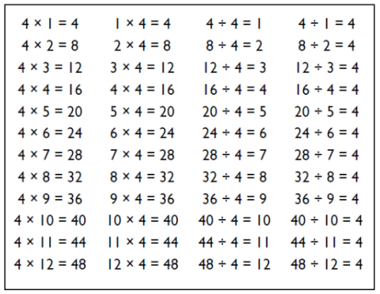
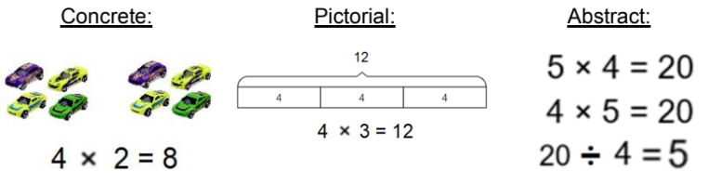
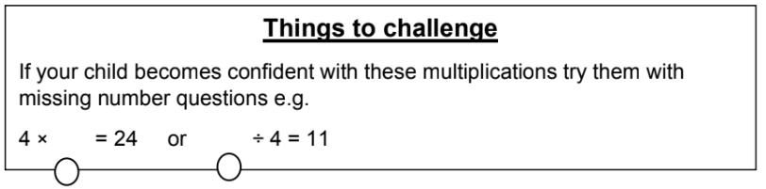
Spring Term 2 – Year 3
I know the multiplication and division facts for the 4 times tables.
A times table is a list of multiples of a given number. They are used in many calculations and having an instant recall of these facts will support the children in many areas of learning.
Key vocabulary:
Multiply
Times
Divide
Shared by
Equals
Activities that can be done at home:
Chants- practice chanting the times table.
Everyday Objects- gather together objects and separate them into groups of 4.
Double & Double again – multiplying by 4 is the same as doubling and doubling again. Double 6 is 12 and double 12 is 24, so 6 × 4 = 24.
https://ttrockstars.com/

Slide 7
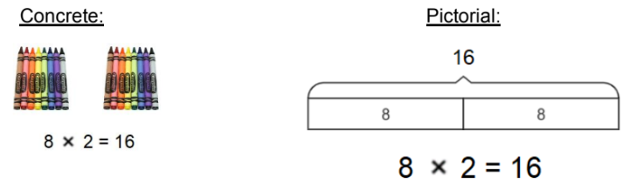
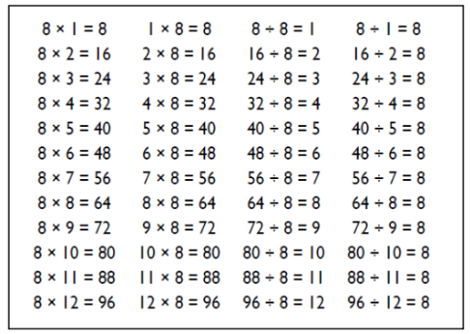
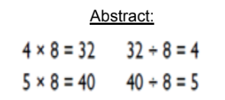
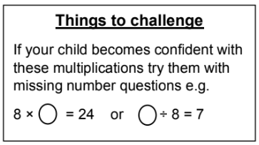
Summer Term 1 – Year 3
I know the multiplication and division facts for the 8 times tables.
A times table is a list of multiples of a given number. They are used in many calculations and having an instant recall of these facts will support the children in many areas of learning.
Key vocabulary:
Multiply
Times
Divide
Shared by
Equals
Activities that can be done at home:
Chants- Practice chanting the times table.
Double your 4’s – Multiplying a number by 8 is like multiplying by 4 and then doubling. 8×4=32 so double 32=64, therefore 8×8=64
Five Six Seven Eight – fifty-six is seven times eight (56=7×8)
https://ttrockstars.com/

Slide 8
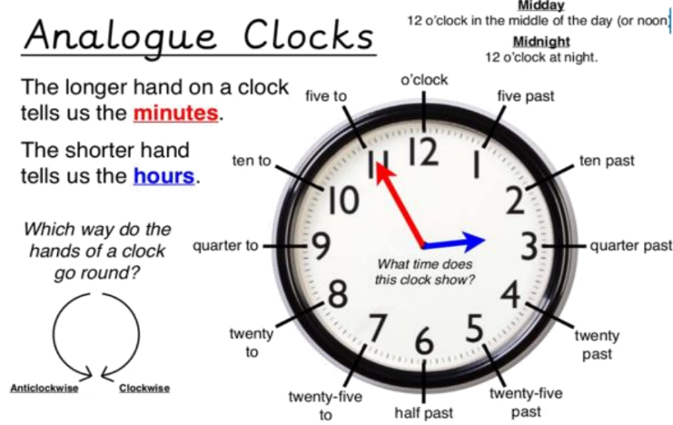
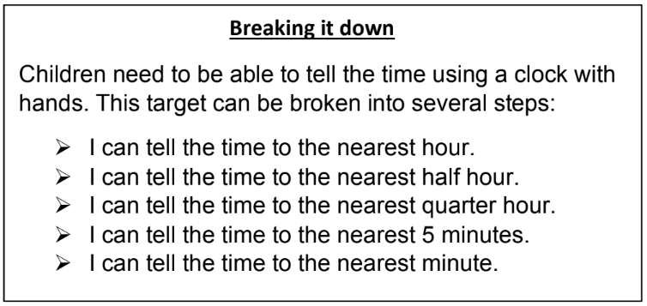
Summer Term 2 – Year 3
I can tell the time to the nearest minute.
Children need to be able to tell the time using a clock with hands (analogue clock). They should already be able to read o’clock, half past, quarter to/past and to the nearest 5 minutes.
Key vocabulary:
The time is 12 o’clock
It is half past two
It is quarter to five
It is twelve minutes past one
It is thirty-six minutes past four.
Activities that can be done at home:
Discuss what time things happen. Try to make sure an analogue clock is visible at home, or the child can use a watch throughout the day.
https://mathsframe.co.uk/en/resources/resource/116/telling_the_time#

