Slide 1

Key Instant Recall Facts
What are KIRFs?
To develop your child’s fluency and mental maths skills, we are introducing KIRFs (Key Instant Recall Facts) throughout the school. KIRFs are a way of helping your child to learn - by heart - key facts and information which they need to have instant recall of.
KIRFs are designed to support the development of mental maths skills that underpin much of the maths work in our school. They are particularly useful when calculating, adding, subtracting, multiplying or dividing. KIRFs contain number facts such as number bonds and times tables that need constant practise and rehearsal so children can recall them quickly and accurately.
Instant recall of facts helps enormously with mental agility in maths lessons. When children move onto written calculations, knowing these key facts is very beneficial as it reduces the cognitive load needed, allowing the children to focus on the higher-level maths. KIRFs are not about challenging the children but making sure ALL children have key mathematical facts at their fingertips.
The secret to success is practising little and often. Can you practise these KIRFs while walking to school or during a car journey? You do not need to practise them all at once; perhaps you could have a fact of the day.

Slide 2
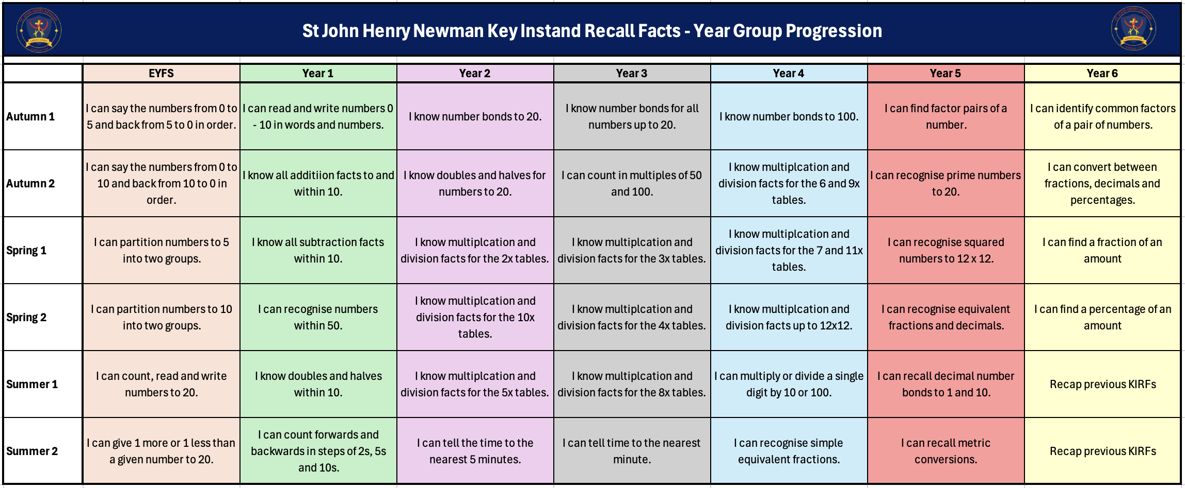
School Overview

Slide 3
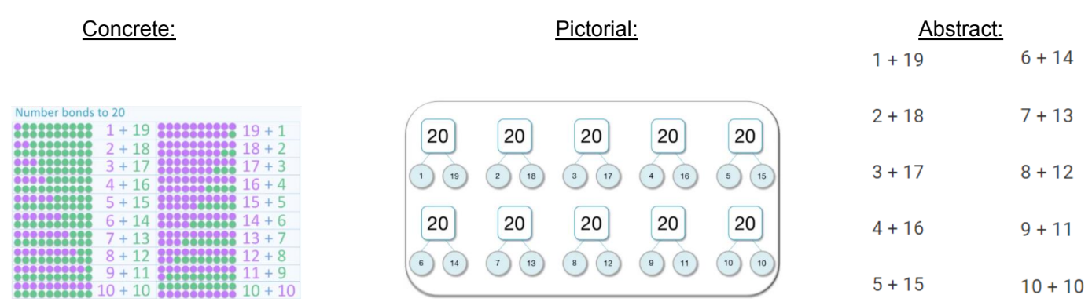

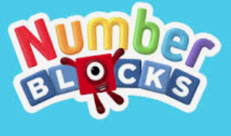
Autumn Term 1 – Year 2
I know the number bonds to 20.
Number bonds show us how numbers join together. They are very important for addition and subtraction. Here, the children are building on their knowledge from Year 1, where they learnt the number bonds to 10.
Key vocabulary:
12 add 8 equals 20
18 plus 2 is the same as 20
20 take away 7 equals 13
20 subtract 3 makes 17
20 minus 9 equals 11
Activities that can be done at home:
Paper Chains- use two different colours to make paper chains to show each number bond, for example 14 + 6 could be shown as 14 green links and 6 blue links.
Say it, make it, write it- for each number bond, say it our loud, make it using everyday objects and then write it as a sum.
Pegs – put 20 pegs on to a coat hanger, split them in different ways and count how many pegs are on each side. E.g. 14 pegs + 6 pegs = 20 pegs (14+6=10).

Slide 4
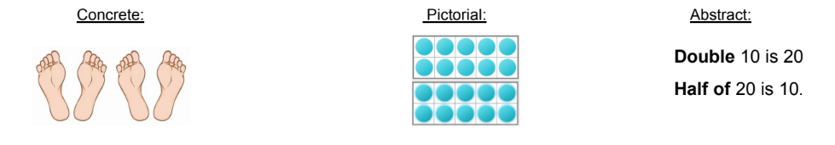
Autumn Term 2 – Year 2
I know doubles and halves to 10.
Children need to understand how to find half, and how to double numbers up to 20.
Key vocabulary:
Double __ is __
Half of __ is __
*Double is the same as multiply 2.
*Half is divided by 2 – shared into two equal groups.
Activities that can be done at home:
Doubling butterfly- Draw an outline of a ladybird, paint spots on one side; fold it over to show double that number. Write the calculation to go with it.
Doubles bingo- Choose 5 numbers between 1-20. Ask questions such as, what is double 6 or what is half of 18. Keep going until all numbers have been crossed off!
Double or nothing- Create a 6 x 6 grid with a numbers 1-24. Working in a pair, roll 2 dice, double the number and cover the number with a counter/object. The first to get 4 in a row wins!

Slide 5
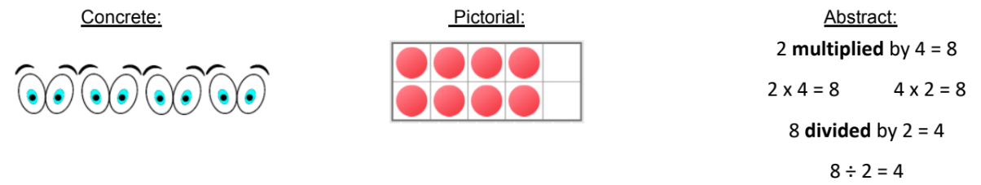

Spring Term 1 – Year 2
I know the multiplication and division facts for the 2 times tables.
The two times table is a key skill for Key Stage 1 learners. They should already be able to count forward and backwards in 2’s, now they need to apply that to multiplication facts.
Key vocabulary:
Multiplying
Lots of
Dividing
Sharing
Grouping
Activities that can be done at home:
Chanting- say the times table facts out loud, 1 times 2 is 2, 2 times 2 is 4 etc.
Can you beat Siri?- ask Siri a 2 times table question, see if they can answer it before Siri does!
Multiplication high fives- draw around your child’s hand 12 times, number each hand 1-12 and position them up the stairs. Ask your child to high five each hand as they go upstairs, multiplying the number in the hand by 2.
Chalk sums- use chalk on an outside patio/path to write out the 2 times table.
https://ttrockstars.com/

Slide 6
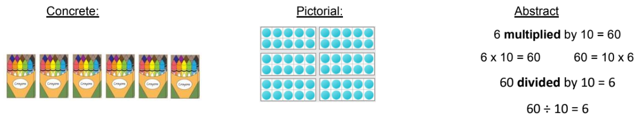
Spring Term 2 – Year 2
I know the multiplication and division facts for the 10 times tables.
The ten times table is a key skill for Key Stage 1 learners. They should already be able to count forward and backwards in 10’s, now they need to apply that to multiplication facts.
Key vocabulary:
Multiplying
Lots of
Dividing
Sharing
Grouping
Activities that can be done at home:
Beat the clock- You have 10 seconds to answers as many questions as you can. Each correct answer will earn you one second of extra time. The game ends when the time runs out or an incorrect answer is given.
Multiplication race– Write the answers to the 10 times table (10, 20, 30 etc.) On large pieces of card. Shout out a random 10 times table question and race your child to the right answer.
10p challenge– Gather some 10p coins, how many pence is there in total? What would this be as a multiplication sum? Change the number of coins and repeat.
https://ttrockstars.com/

Slide 7
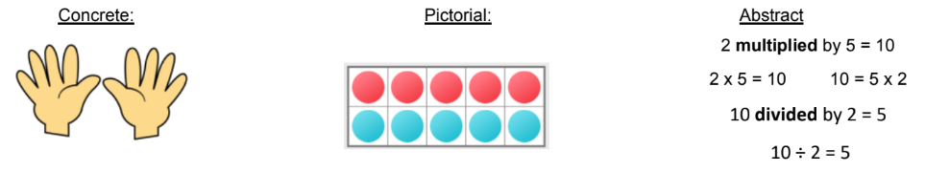
Summer Term 1 – Year 2
I know the multiplication and division facts for the 5 times tables.
The five times table is a key skill for Key Stage 1 learners. They should already be able to count forward and backwards in 5’s, now they need to apply that to multiplication facts.
Key vocabulary:
Multiplying
Lots of
Dividing
Sharing
Grouping
Activities that can be done at home:
5 times table song- Play a 5 times table song in the car when travelling.
Can you beat the calculator? - Ask your child a 5 times table question, see if they can answer it before you type it into a calculator!
How many fingers and toes? - Draw around all of the hands and feet in your household, how many fingers and toes are there altogether?
Skip count – Go outside, use chalk to write the numbers 1-12 in a random order. Jump, skip or hop along the numbers, multiplying each number by 5 as you go.
https://ttrockstars.com/

Slide 8
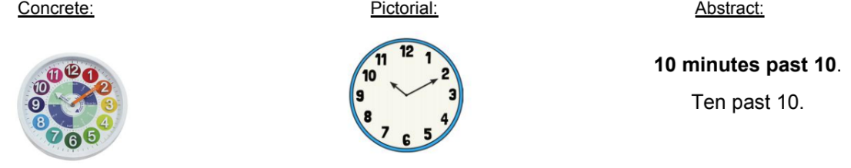
Summer Term 2 – Year 2
I can tell the time to the nearest 5 minutes.
Children need to be able to tell the time using a clock with hands (analogue clock). They should already be able to read o’clock, half past and quarter to/past.
Key vocabulary:
Minute hand – the longer hand.
Hour hand – the shorter hand.
Half past – 30 minutes past the hour.
O’clock – on the hour
Quarter past – 15 minutes past the hour.
Quarter to – 45 minutes past the hour
Activities that can be done at home:
What time is it?- Find as many opportunities as possible to ask your child what time it is throughout the day. This will also help them to understand what happens at different times.
Hula hoop clock- Use a hula hoop, chalk for the numbers and some sticks to make your own clock.
Time monitoring- Give your child responsibility for keeping track of the time, for example ‘We need to take the cakes out of the oven at 5 past 2. Tell me when that is.’
https://mathsframe.co.uk/en/resources/resource/116/telling_the_time#

