Slide 1

Key Instant Recall Facts
What are KIRFs?
To develop your child’s fluency and mental maths skills, we are introducing KIRFs (Key Instant Recall Facts) throughout the school. KIRFs are a way of helping your child to learn - by heart - key facts and information which they need to have instant recall of.
KIRFs are designed to support the development of mental maths skills that underpin much of the maths work in our school. They are particularly useful when calculating, adding, subtracting, multiplying or dividing. KIRFs contain number facts such as number bonds and times tables that need constant practise and rehearsal so children can recall them quickly and accurately.
Instant recall of facts helps enormously with mental agility in maths lessons. When children move onto written calculations, knowing these key facts is very beneficial as it reduces the cognitive load needed, allowing the children to focus on the higher-level maths. KIRFs are not about challenging the children but making sure ALL children have key mathematical facts at their fingertips.
The secret to success is practising little and often. Can you practise these KIRFs while walking to school or during a car journey? You do not need to practise them all at once; perhaps you could have a fact of the day.

Slide 2
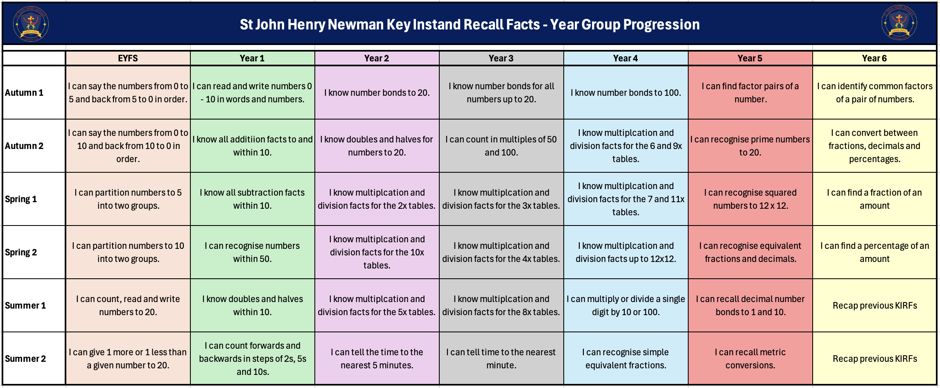
School Overview

Slide 3
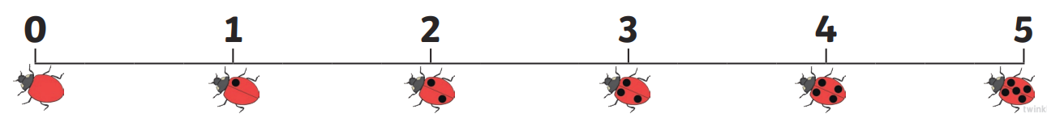
Autumn Term 1 - Reception
I can say the numbers from 0 to 5 and back from 5 to 0 in order.
In order: 0, 1, 2, 3, 4, 5
And back again: 5, 4, 3, 2, 1, 0
Key vocabulary:
Zero
One
Two
Three
Four
Five
Activities that can be done at home:
Counting objects around the home, making piles of 0, 1, 2, 3, 4 and 5, and then counting them in order to 5 and back. You could use: Lego, fruit, stones, leaves, sweets, pasta, toys etc.
Looking for numbers up to 5 around the home and when you are out and about…..can they count on or back from that number? “How many cars are there in the car park? How many children are on the swings?”
Singing number songs where the numbers are going backwards: Five little speckled frogs; Five little monkeys jumping on the bed etc.

Slide 4
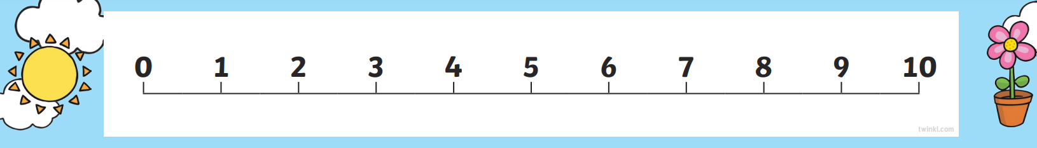
Autumn Term 2 - Reception
I can say the numbers from 0 to 10 and back from 10 to 0 in order.
In order: 0, 1, 2, 3, 4, 5, 6, 7, 8, 9, 10
And back again: 10, 9, 8, 7, 6, 5, 4, 3, 2, 1, 0
Key vocabulary:
Six
Seven
Eight
Nine
Ten
Activities that can be done at home:
Counting objects around the home, making piles of 0, 1, 2, 3, 4, 5, 6, 7, 8, 9 and 10 and then counting them in order to 5 and back. You could use : Lego, fruit, stones, leaves, sweets, pasta, toys etc.
Looking for numbers up to 10 around the home and when you are out and about…..can they count on or back from that number? “Can you count 10 people on the bus?”, “Can you count ten flowers from the garden?”
What can you do in 10 seconds? Take it in turns with your child to count while the other performs the task, such as star jumps, building a tower, tidying their rooms.

Slide 5
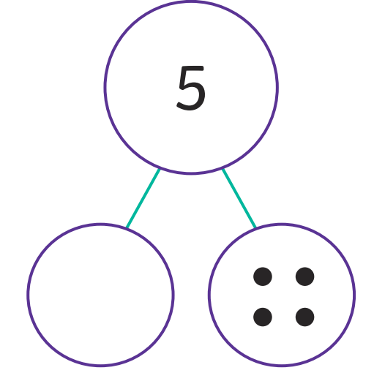

Spring Term 1 - Reception
I can partition numbers, to 5, into two groups.
Key vocabulary:
______ and _____ make _______
Zero and five make five.
One and four make five.
Two and three make five.
Activities that can be done at home:
Using items around the house to find different ways of making 5, e.g. four blue cars and one red car. Four and one make five.
Making up stories with items around the home, e.g. there are 2 potatoes in the cupboard, and we buy 3 more, how many potatoes altogether? Two and three make five.
Asking questions during daily routines, e.g. you have 1 sausage on your plate, and I have 4 sausages on my plate, how many sausages altogether? One and four make five.

Slide 6

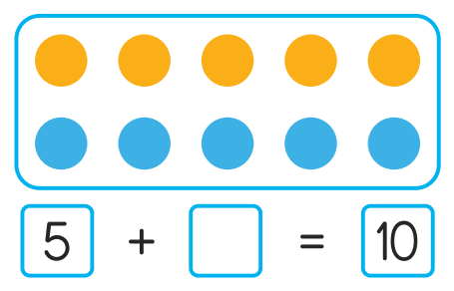
Spring Term 2 - Reception
I can partition numbers, to 10, into two groups.
Key vocabulary:
______ and _____ make _______
Zero and ten make ten.
One and nine make ten.
Two and eight make ten.
Three and seven make ten.
Four and six make ten.
Five and five make ten.
Activities that can be done at home:
Using items around the house to find different ways of making 10, e.g. one blue teddy and nine red teddies. One and nine make ten.
Asking questions during daily routines, e.g. you have 4 carrots on your plate, and I have 6 carrots on my plate, how many carrots altogether? Four and six make ten.
Jack Hartmann Number bonds to 10 singing and moving you tube clip! https://www.youtube.com/watch?v=lD9tjBUiXs0 Number bonds to 10 https://www.youtube.com/watch?v=ch7KzI3n2Zk Number pairs to 10

Slide 7
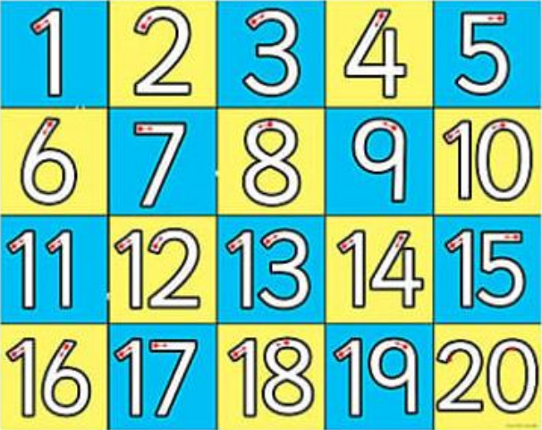
Summer Term 1 - Reception
I can count, read and write numbers to 20.
Key vocabulary:
Eleven
Twelve
Thirteen
Fourteen
Fifteen
Sixteen
Seventeen
Eighteen
Nineteen
Twenty
Activities that can be done at home:
Counting objects around the home finding methods of counting accurately, e.g. moving each object as it is counted…….use sweets, Lego, fruit, stones, leaves etc
Looking for numbers up to 20 around the home and when you are out and about: on signs, in the shops etc.
Count objects around the home and then write the correct numeral to match the quantity counted. Repeat with other numbers. Discuss which number is the biggest/smallest or is more/less than the other. How do you know?

Slide 8
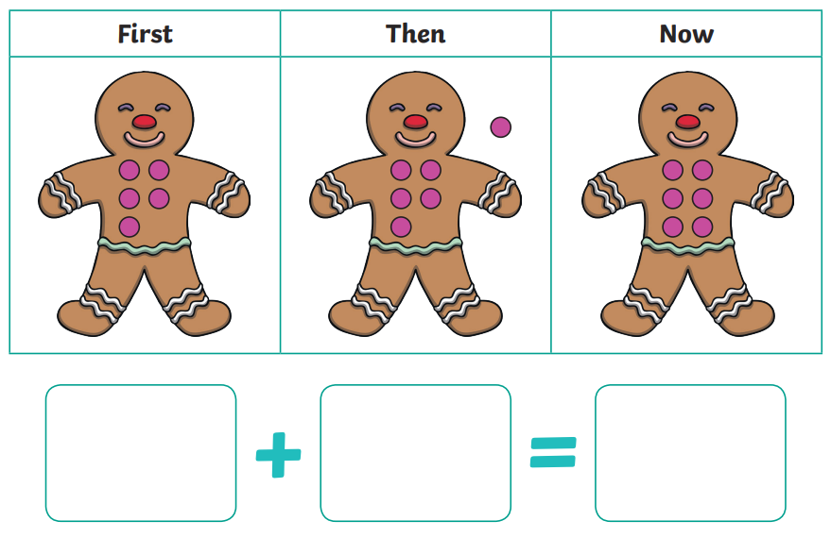
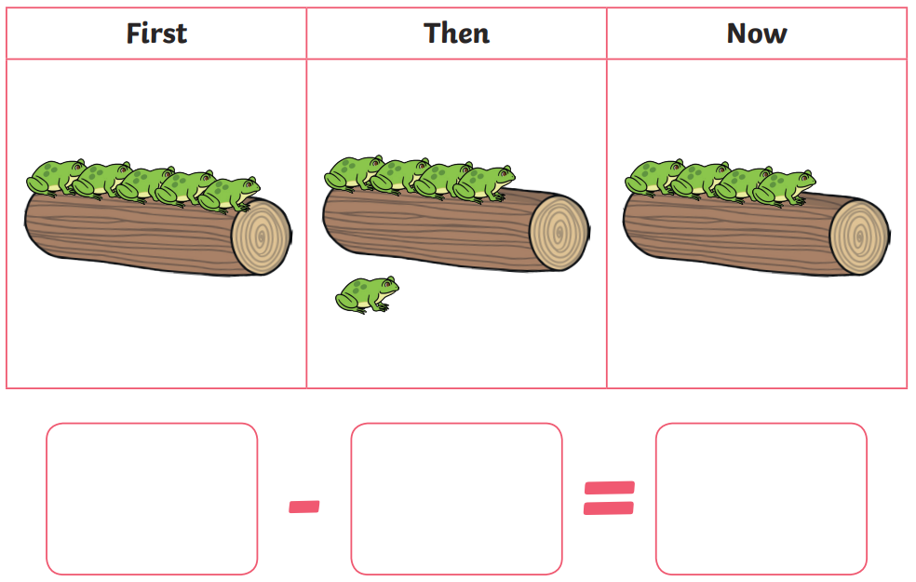
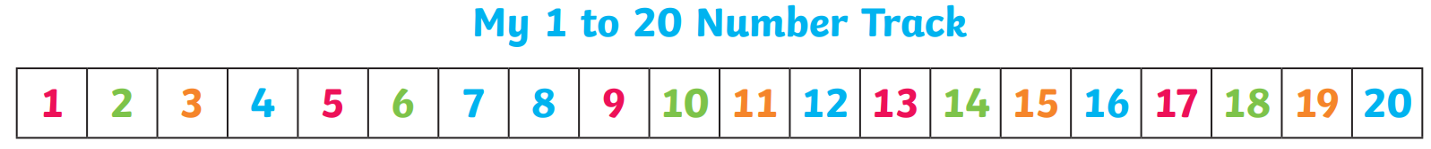
Summer Term 2 - Reception
I can give 1 more or 1 less than a given number to 20.
Key vocabulary:
1 more than _______ is _______.
1 less than _______ is _______.
Activities that can be done at home:
Making up stories with items around the home, e.g. there are 7 cars in the car park and 1 more cars arrive, how many cars altogether? Count on from the 7 to find the answer.
Asking questions during daily routines, e.g. you have 8 chips on your plate, and I take 1, how many are left? Count back from 8 to find the answer.
A number track (like the one in the picture) is very useful to practise counting on and back.

