Slide 1

Key Instant Recall Facts
What are KIRFs?
To develop your child’s fluency and mental maths skills, we are introducing KIRFs (Key Instant Recall Facts) throughout the school. KIRFs are a way of helping your child to learn - by heart - key facts and information which they need to have instant recall of.
KIRFs are designed to support the development of mental maths skills that underpin much of the maths work in our school. They are particularly useful when calculating, adding, subtracting, multiplying or dividing. KIRFs contain number facts such as number bonds and times tables that need constant practise and rehearsal so children can recall them quickly and accurately.
Instant recall of facts helps enormously with mental agility in maths lessons. When children move onto written calculations, knowing these key facts is very beneficial as it reduces the cognitive load needed, allowing the children to focus on the higher-level maths. KIRFs are not about challenging the children but making sure ALL children have key mathematical facts at their fingertips.
The secret to success is practising little and often. Can you practise these KIRFs while walking to school or during a car journey? You do not need to practise them all at once; perhaps you could have a fact of the day.

Slide 2
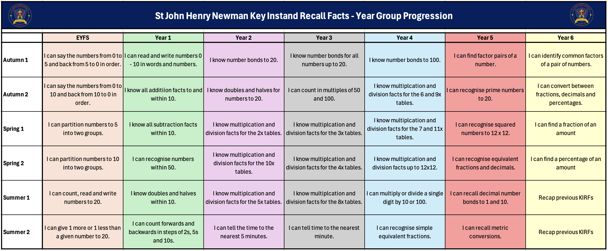
School Overview

Slide 3
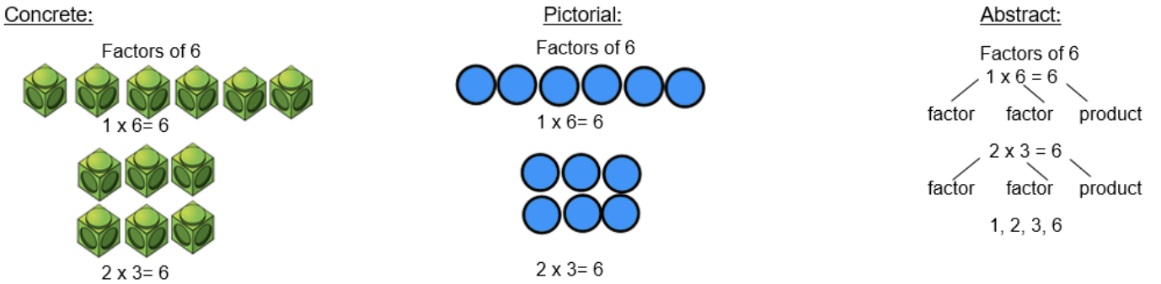
Autumn Term 1 – Year 5
I can find factor pairs of a number.
Children should now know all multiplication and division facts up to 12 × 12. When given a number in one of
these times tables, they should be able to state a factor pair which multiply to make this number.
For example, factor pairs for 8 are: 1 and 8 and 2 and 4.
Key vocabulary:
Composite number- Numbers that have more than 2 factors.
Prime number - A whole number with only
two factors, one and the number itself.
Factor- A factor of a number is a number that divides the given number evenly or exactly, leaving no remainder.
Multiple -A multiple is the product result of one number multiplied by another number.
Activities that can be done at home:
https://www.topmarks.co.uk/maths-games/multiples-and-factors
https://www.mathnook.com/math/math-speed-racing-factors.html
https://www.math-play.com/Factors-Millionaire/factors-millionaire-game_html5.html https://www.bbc.co.uk/bitesize/topics/zfq7hyc/articles/zp6wfcw

Slide 4
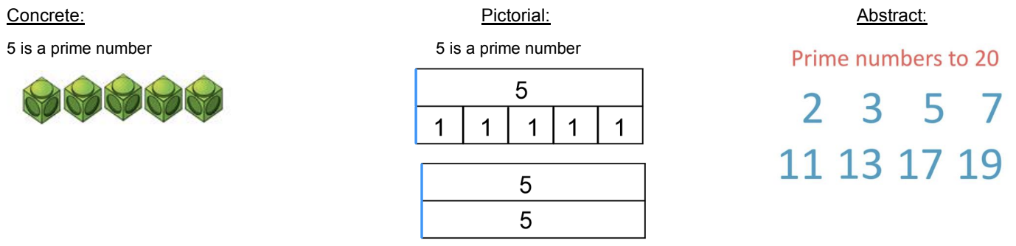
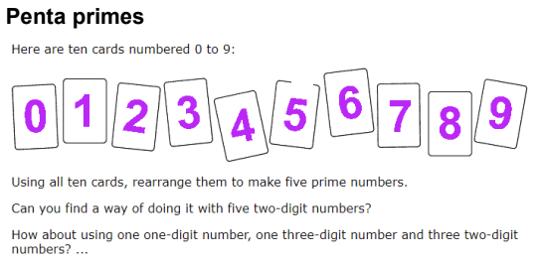
Autumn Term 2 – Year 5
I can identify prime numbers up to 20.
A prime number is a number with only two factors: itself and one. The aim is for children to recall the prime
numbers to 20 instantly.
Key vocabulary:
Array- An ordered collection of counters,
cubes or other item in rows and columns.
Factor- A factor of a number is a number that divides the given number evenly or exactly, leaving no remainder.
Product- The result of multiplying one number
by another.
Activities that can be done at home:
https://www.bbc.co.uk/bitesize/topics/zfq7hyc/articles/z2q26fr
https://www.transum.org/Maths/Game/Prime_Pairs/
https://www.primarygames.com/math/matheggsprime/

Slide 5

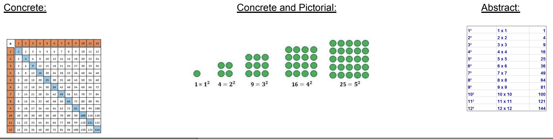
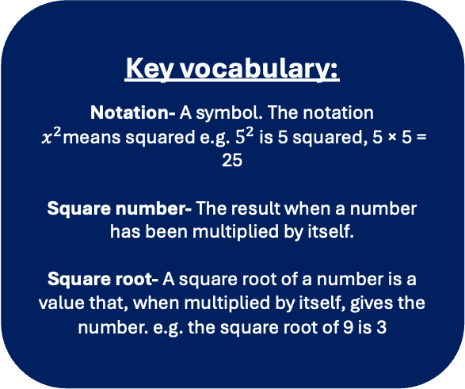
Spring Term 1 – Year 5
I can recall square numbers up to ${12}^{2}$ and their square roots.
Square numbers have an odd number of factors and are the result of multiplying a whole number by itself. The aim is for children to recall square numbers, and their square roots up to 144 instantly.
Key vocabulary:
Notation- A symbol. The notation
$x^{2}$means squared e.g. $5^{2}$ is 5 squared, 5 × 5 = 25
Square number- The result when a number has been multiplied by itself.
Square root- A square root of a number is a
value that, when multiplied by itself, gives the
number. e.g. the square root of 9 is 3
Activities that can be done at home:
Around the clock - think of a clock face. What are each of the numbers a square root of? E.g. 12: 12 is the square root of 144. What are each of the numbers squared?
Dice roll - whatever the number lands on, square it
Cards - turn a card over, square it and call out the answer. Can you say the answer quicker than your partner?
https://www.bbc.co.uk/bitesize/topics/zfq7hyc/articles/z2ndsrd

Slide 6
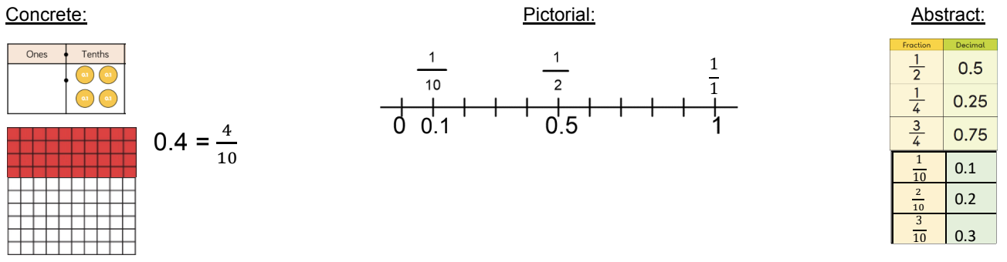
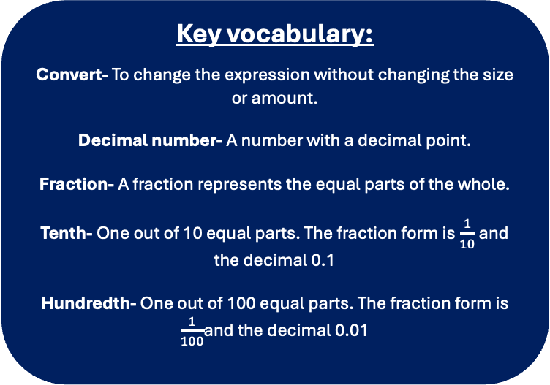
Spring Term 2 – Year 5
I can recognise equivalent fractions and decimals.
Children should be able to convert between fractions and decimals and recall common decimal and fraction equivalences instantly.
Key vocabulary:
Convert- To change the expression without changing the size or amount.
Decimal number- A number with a decimal point.
Fraction- A fraction represents the equal parts of the whole.
Tenth- One out of 10 equal parts. The fraction form is $\frac{1}{10}$ and the decimal 0.1
Hundredth- One out of 100 equal parts. The fraction form is $\frac{1}{100}$and the decimal 0.01
Activities that can be done at home:
Dominos- write the fraction and decimal the domino is showing
Bingo- make your own fraction to decimal bingo game
Pairs game- make your own fraction and decimal card matching game
https://www.bbc.co.uk/bitesize/topics/zhdwxnb/articles/zwkhxbk

Slide 7
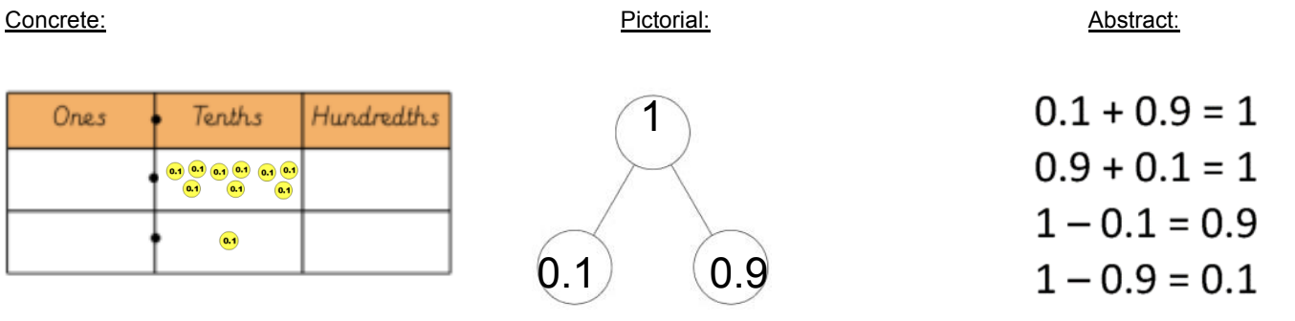
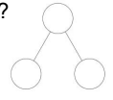
Summer Term 1 – Year 5
I know decimal number bonds to 1 and 10.
Children should see the links with number bonds to 10, 100 and 1000 to identify decimal number bonds to 1 and 10 and recall these instantly.
Key vocabulary:
Complements- In addition, a number and its
complement make a total e.g. 0.3 is the
complement of 0.7 to make 1
Decimal number- A number with a decimal point.
Number bonds- Pairs of numbers that add
together to make another number.
Sum- The result of an addition
Activities that can be done at home:
Part part whole- Use the part part whole model to create your own decimal number bonds. How many ways can you make 1? How many ways can you make 10?
Use money- how many ways can you make £1? E.g. 0.90p + 0.10p Website: https://www.topmarks.co.uk/learning-to-count/paint-the-squares
Part whole model

Slide 8
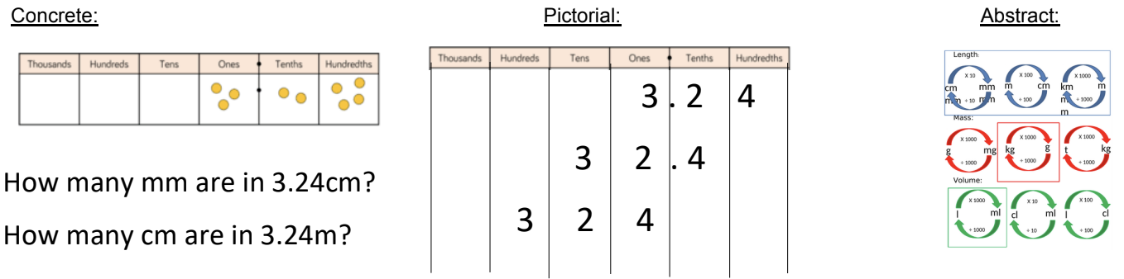
Summer Term 2 – Year 5
I can recall metric conversions.
Children should be able to convert between metric units of mass, length and capacity.
Key vocabulary:
Capacity- How much of a solid, liquid or gas an object can hold.
Convert- To change the expression without changing the size or amount.
Length- The measurement of something from
end to end.
Mass- How much an object weighs.
Metric units- Units of measurement using the powers of 10.
Activities that can be done at home:
Measure up- measure the length, mass and volume of different items in your home. Show the measurements in different units of measures.
Ready steady cook- help out in the kitchen to follow a recipe. Can you convert the units of measures?
https://uk.splashlearn.com/measurement-games
https://www.ictgames.com/mobilePage/mostlyPostie/index.html

