Slide 1

Key Instant Recall Facts
What are KIRFs?
To develop your child’s fluency and mental maths skills, we are introducing KIRFs (Key Instant Recall Facts) throughout the school. KIRFs are a way of helping your child to learn - by heart - key facts and information which they need to have instant recall of.
KIRFs are designed to support the development of mental maths skills that underpin much of the maths work in our school. They are particularly useful when calculating, adding, subtracting, multiplying or dividing. KIRFs contain number facts such as number bonds and times tables that need constant practise and rehearsal so children can recall them quickly and accurately.
Instant recall of facts helps enormously with mental agility in maths lessons. When children move onto written calculations, knowing these key facts is very beneficial as it reduces the cognitive load needed, allowing the children to focus on the higher-level maths. KIRFs are not about challenging the children but making sure ALL children have key mathematical facts at their fingertips.
The secret to success is practising little and often. Can you practise these KIRFs while walking to school or during a car journey? You do not need to practise them all at once; perhaps you could have a fact of the day.

Slide 2
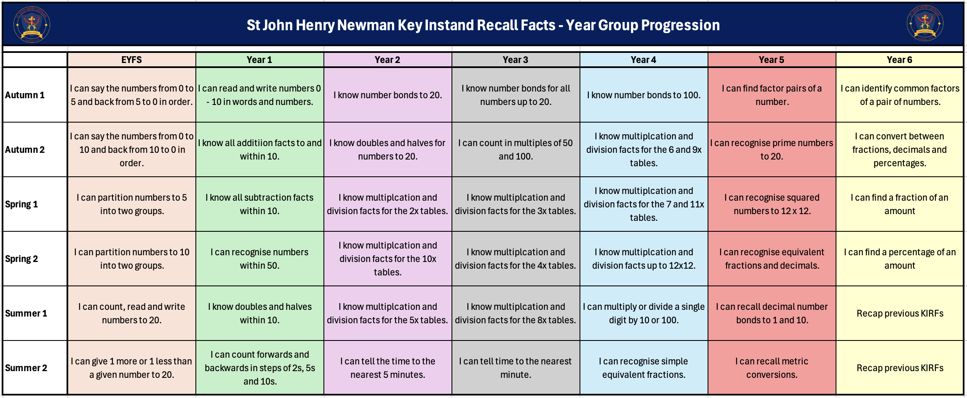
School Overview

Slide 3
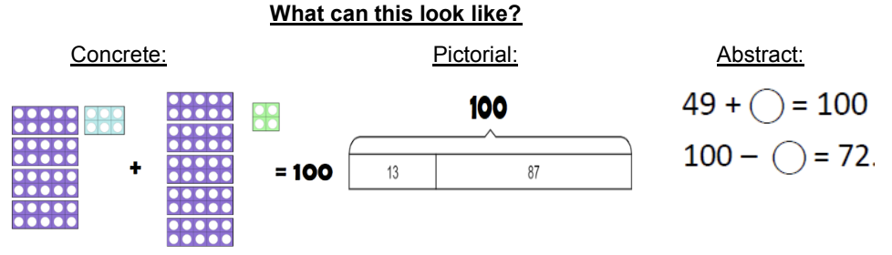
Autumn Term 1 – Year 4
I know the number bonds to 100.
Number bonds show us how numbers join together. They are very important for addition and subtraction.
This half term, we would like the children to practice their number bonds to 100.
Key vocabulary:
Add
Equals
Total
The same as
Subtract
Take away
The difference
Activities that can be done at home:
Chants - Practice chanting the number bonds.
Make a poster – We use lots of concrete, pictorial and abstract methods in school. Your child could make a poster showing different methods to make the number bonds to 100.
Use your number bonds to 10 – Think about your number bonds to 10 and how they might help you. E.g.4+6=10 therefore 40+60=100
https://www.topmarks.co.uk/maths-games/hit-the-button for number bonds to 100.

Slide 4

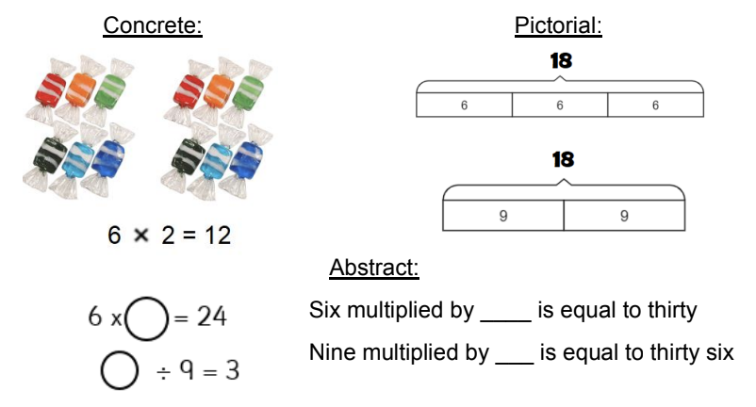
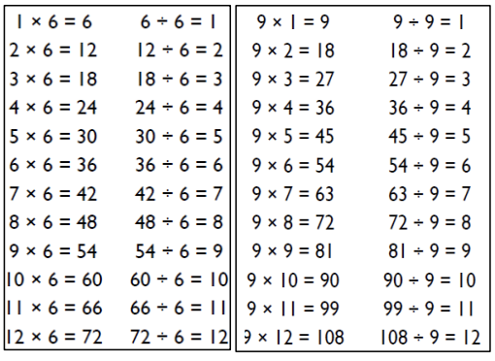
Autumn Term 2 – Year 4
I know the 6- & 9-times tables (x and ÷).
A times table is a list of multiples of the given number. They are very important for many calculations. This half term, the children will be learning their 6- and 9-times tables including the division facts.
Key vocabulary:
Multiply
Times
Divide
Shared by
Equals
Activities that can be done at home:
Chants- Practice chanting the times table.
Double your 3’s (for your 6’s) – 3x4=12 double 12 equals 24. So 6x4=24
Use 10 times table (for your 9’s) – Multiply a number by 10 then subtract off the original number. E.g. 7x10=70 subtract off the original number 70-7=63 so 9x7=63
https://ttrockstars.com/

Slide 5
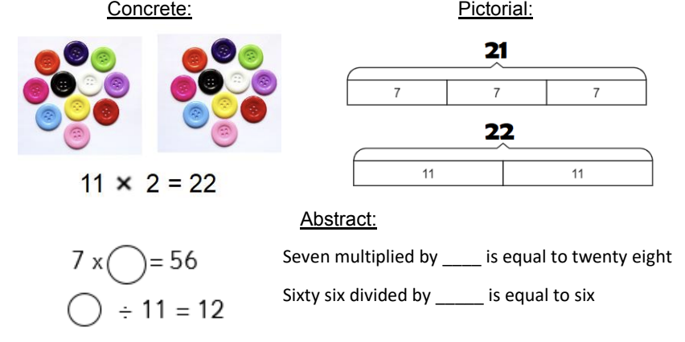
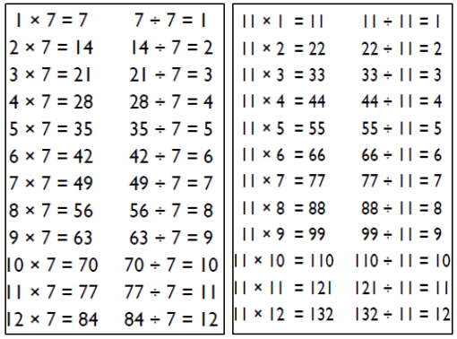
Spring Term 1 – Year 4
I know the 7- & 11-times tables (x and ÷).
A times table is a list of multiples of the given number. They are very important for many calculations. This half term, the children will be learning their 7- and 11-times tables including the division facts.
Key vocabulary:
Multiply
Times
Divide
Shared by
Equals
Activities that can be done at home:
Chants- Practice chanting the times table.
Look for patterns – The 11 times table follows a pattern. Can you spot it?
Use your other times tables – You’ve already learnt most of your other times tables. All of these included your 7’s & 11’s. Use them to help.
https://ttrockstars.com/

Slide 6
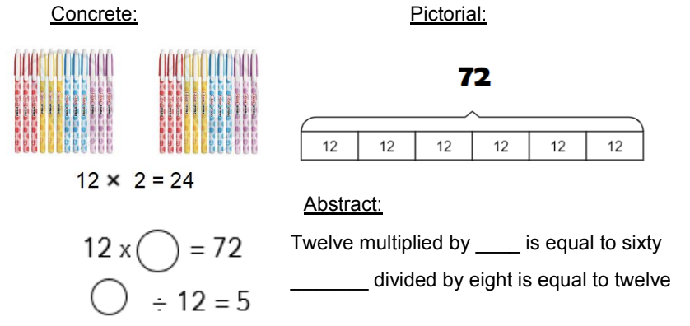
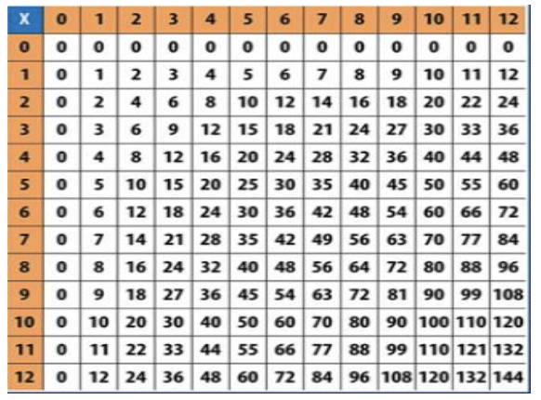
Spring Term 2 – Year 4
I know the multiplication and division facts up to 12 x 12.
A times table is a list of multiples of the given number. They are very important for many calculations. This half term, the children will be practicing their multiplication and division facts up to 12x12.
Key vocabulary:
Multiply
Times
Divide
Shared by
Equals
Activities that can be done at home:
Speed Challenge – Take two packs of playing cards and remove the kings. Shuffle the packs and turn over two cards and ask your child to multiply the numbers together (Ace=1, Jack = 11, Queen = 12). How many questions can they answer correctly in 2 minutes? Practice regularly and see if they can beat their high score.
https://ttrockstars.com/

Slide 7
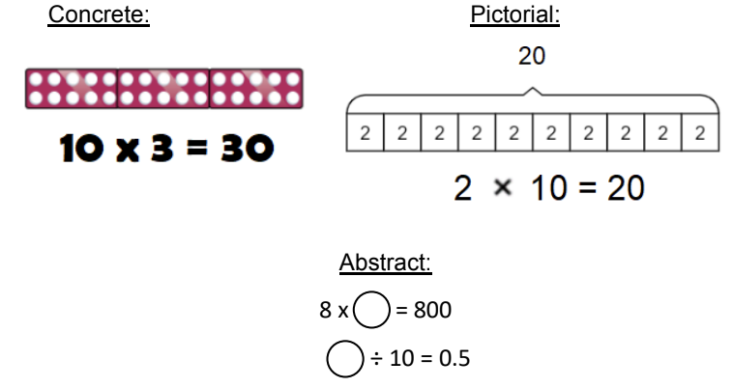
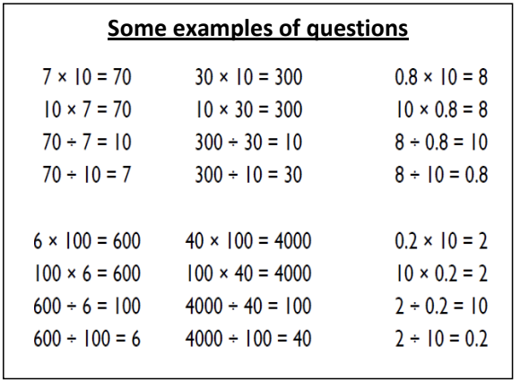
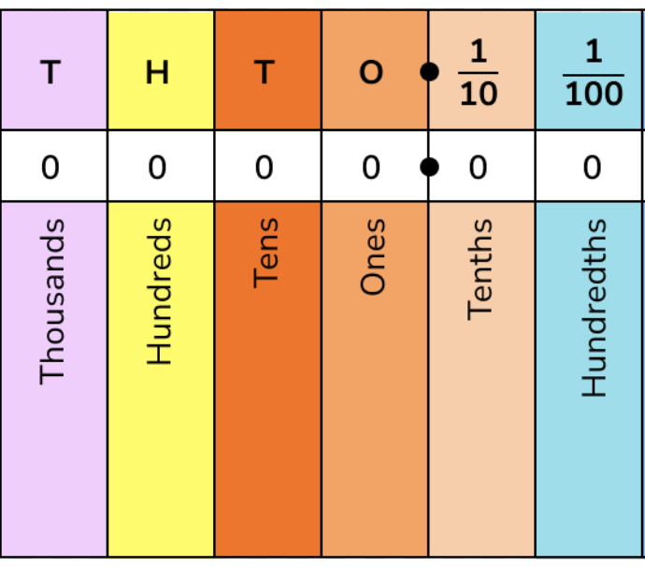
Summer Term 1 – Year 4
I can multiply and divide a single digit by 10 & 100.
This half term, the children should practice how to multiply and divide a single digit by 10 and 100.
Key vocabulary:
Multiply
Times
Divide
Shared by
Equals
Activities that can be done at home:
Use place value charts to practice multiplying and dividing numbers by 10 and 100. *We teach that the number moves to the left and the right, not the decimal point.
Buy one get three free – If your child knows one fact (e.g. 12 x 4 = 48), can they tell you the other three facts in the same fact family?
https://ttrockstars.com/
https://www.topmarks.co.uk/Flash.aspx?f=bingotimesordivide
Remember, when multiplying, the number moves to the left. When dividing, the number moves to the right.

Slide 8
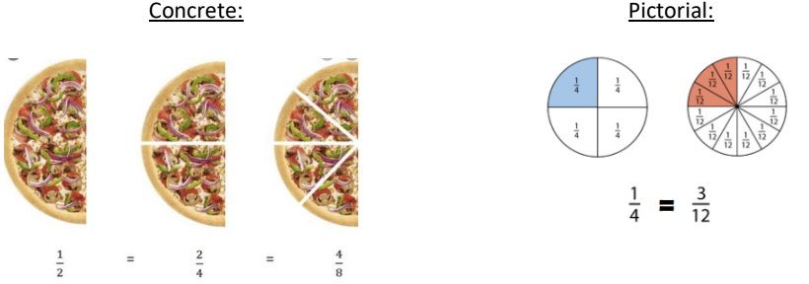
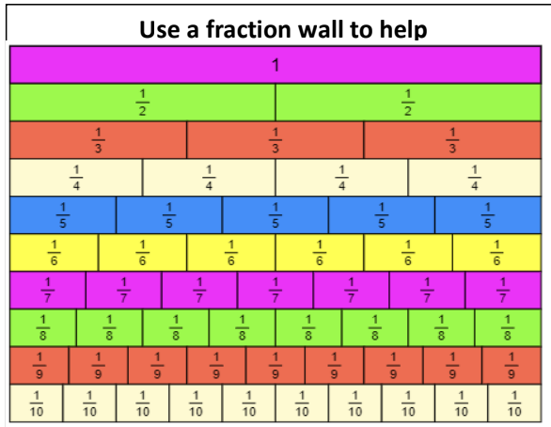
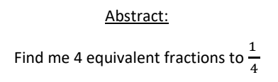
Summer Term 2 – Year 4
I can recognise simple equivalent fractions
When two fractions have different numerators and denominators to one another but share the same
numerical value, they are called ‘equivalent fractions’. The aim is to be able to recall some of these instantly.
Key vocabulary:
Equivalent
Equal
The same as
Numerator
Denominator
Activities that can be done at home:
Create fraction cards using paper to show how different fractions are equivalent.
https://phet.colorado.edu/sims/html/fractions-equality/latest/fractions-equality_en.html
https://www.bbc.co.uk/bitesize/topics/zhdwxnb/articles/zbqkvwx

