Slide 1

Key Instant Recall Facts
What are KIRFs?
To develop your child’s fluency and mental maths skills, we are introducing KIRFs (Key Instant Recall Facts) throughout the school. KIRFs are a way of helping your child to learn - by heart - key facts and information which they need to have instant recall of.
KIRFs are designed to support the development of mental maths skills that underpin much of the maths work in our school. They are particularly useful when calculating, adding, subtracting, multiplying or dividing. KIRFs contain number facts such as number bonds and times tables that need constant practise and rehearsal so children can recall them quickly and accurately.
Instant recall of facts helps enormously with mental agility in maths lessons. When children move onto written calculations, knowing these key facts is very beneficial as it reduces the cognitive load needed, allowing the children to focus on the higher-level maths. KIRFs are not about challenging the children but making sure ALL children have key mathematical facts at their fingertips.
The secret to success is practising little and often. Can you practise these KIRFs while walking to school or during a car journey? You do not need to practise them all at once; perhaps you could have a fact of the day.

Slide 2
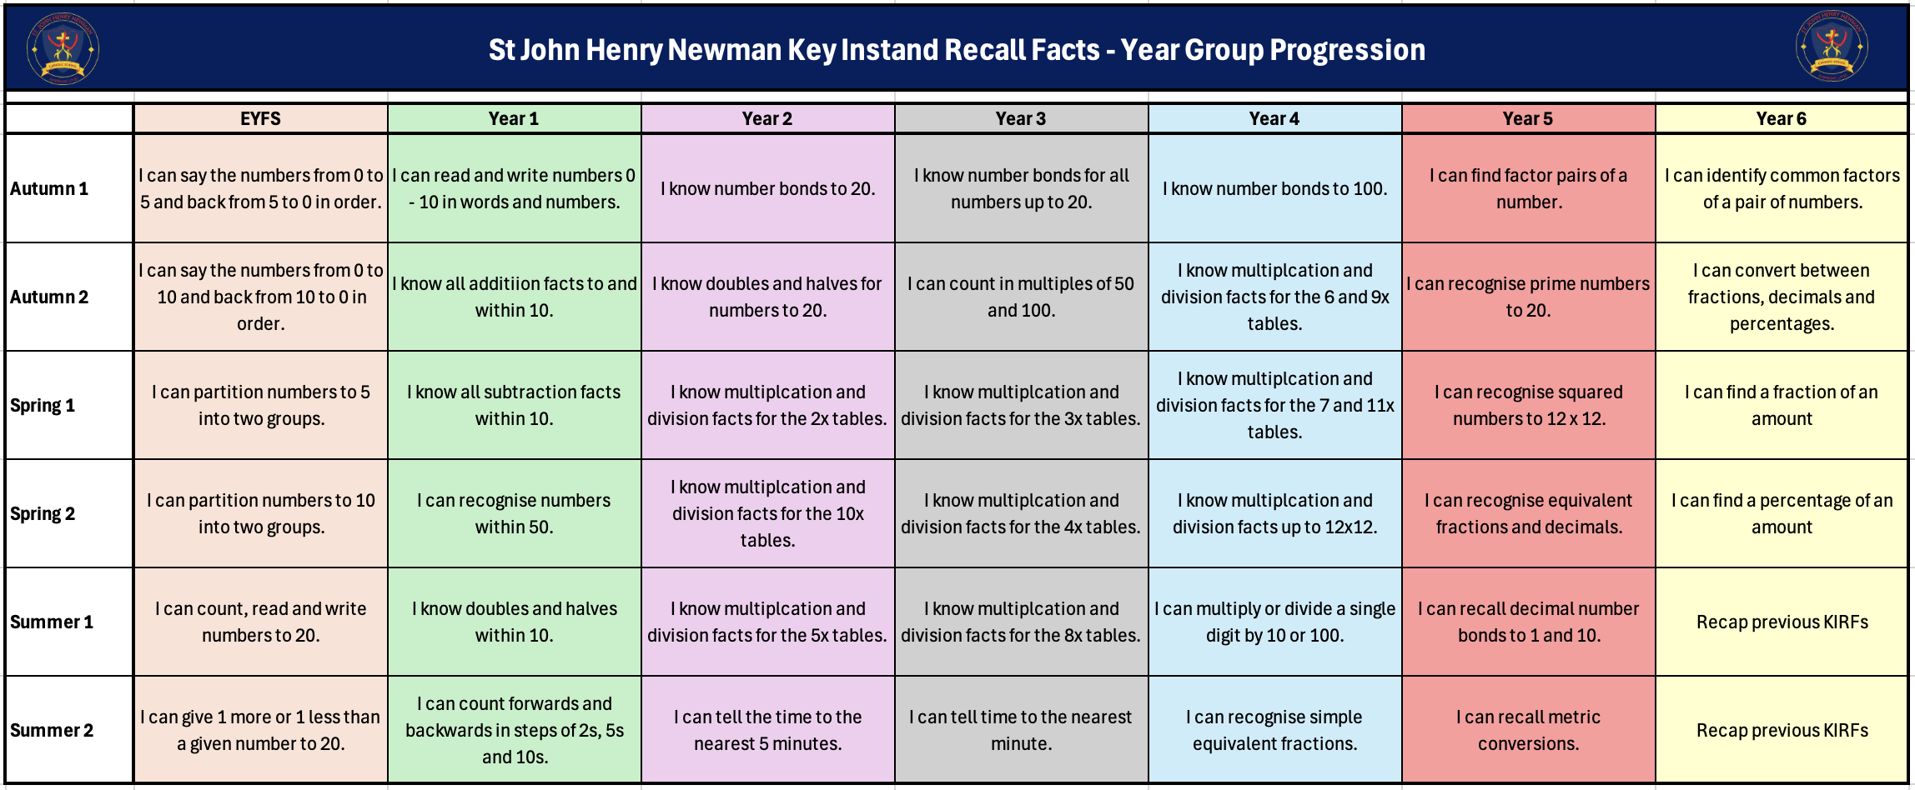
School Overview

Slide 3
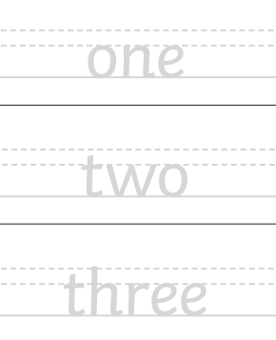
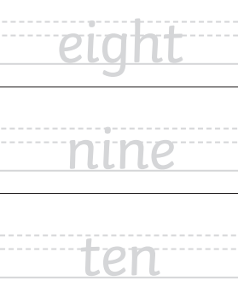
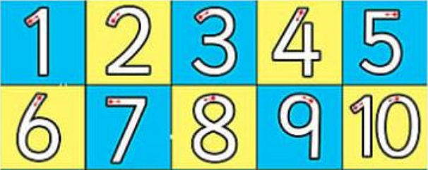
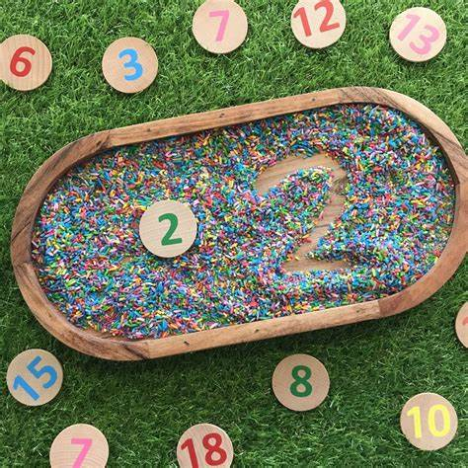
Autumn Term 1 – Year 1
I can read and write numbers zero to ten in words and numbers.
Key vocabulary:
Zero
One
Two
Three
Four
Five
Six
Seven
Eight
Nine
Ten
Activities that can be done at home:
Practice tracing and copying number and letter formation. This can be done on whiteboards, paper, in a bowl of rice or on a tablet.
Have words and digits around the house and match them.
Ask the children to spell numbers throughout the day.
https://mathgames.org/library/number-writing/

Slide 4
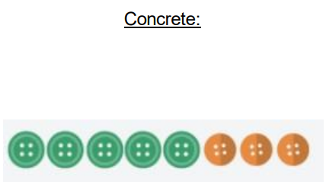
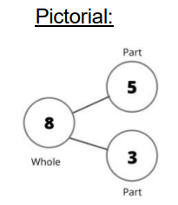
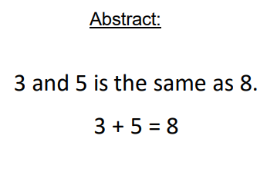

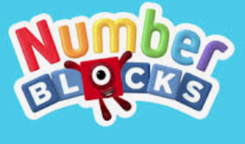
Autumn Term 2 – Year 1
I know all addition facts to and within 10.
Number bonds to and within 10 are addition calculations that make every number between 1-10. There are number bonds for every number to 10, for example: 7+0 = 7, 6+1= 7, 5+2= 7, 4+3=7.
Key vocabulary:
2 add 6 equals 8
2 + 6 = 8
3 plus 2 is the same as 5
3 + 2 = 5
10 and 0 makes 10
10 + 0 = 10
Activities that can be done at home:
Ball throw- Write the numbers 1-10 on large pieces of paper. Call out a number to your child and challenge them to throw a ball at two numbers that make that number.
Facts bingo- Write the numbers 1-10 in a simple grid. Say; I want to make ___, I have____ what do I need to add?
Spinner– Make a simple spinner, decide on a number to make and then spin the spinner. What number do you need to add to make the original number?
Numberblocks - https://www.bbc.co.uk/iplayer/episodes/b08bzfnh/numberblocks?scrlybrkr=ccf896f9

Slide 5
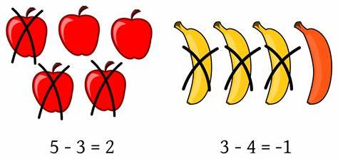


Spring Term 1 – Year 1
I know all subtraction facts for numbers within 10.
Subtraction facts within 10 further develop children’s understanding of number bonds: 9-2=7, 10-3=7, 6 – 4 = 2.
Key vocabulary:
__ subtract ___ equals __
__ take away __ makes __
Activities that can be done at home:
Use items around the house in day-to-day tasks. There are 2 potatoes on your plate and 4 on mine. How many potatoes do we have altogether? 2 add 4 makes___. There are nine plates in the sink, if I wash and put away four, how many are left? 9 subtract 4 equals ___.
Create a poster to show different ways of making numbers up to ten.
  You can find pictures of the Numicon shapes here: www.bit.ly/NumiconPictures
  Numberblock pictures - https://mondaymandala.com/numberblocks-coloring-pages/

Slide 6
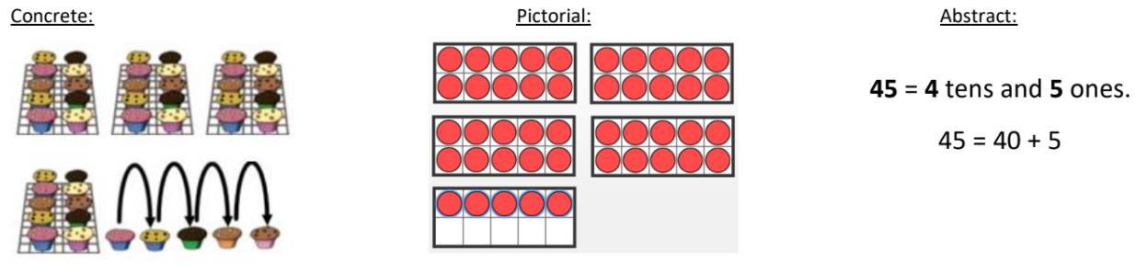
Spring Term 2 – Year 1
I can recognise numbers within 50.
Children should use their knowledge of numbers to 20 to partition numbers to 50 into tens and ones.
45 has 4 tens and 5 ones.
Key vocabulary:
___ is made of __ tens and ___ ones.
There are ___ tens in ___.
Activities that can be done at home:
Counting objects- Look around your home, can you find 25 objects? Count them out loud.
Egg box numbers- Use a 10-egg box (or cut 2 off a 12 box) and use this to make groups of 10. Encourage them to check they have filled each hole to make sure they have 10.
Number hunt– Go for a walk and see how many numbers between 1-50 you can spot, support your child to read each number aloud and talk about the number of tens and one in each number.
White Rose video on numbers to 50: https://vimeo.com/500466597?scrlybrkr=ccf896f9
https://www.topmarks.co.uk/learning-to-count/place-value-basketball

Slide 7
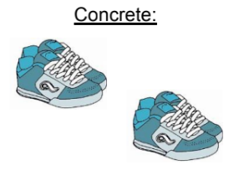
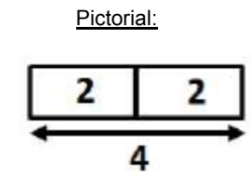
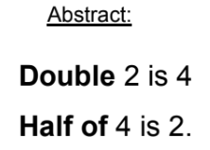
Summer Term 1 – Year 1
I know doubles and halves within 10.
0+ 0 = 0, 1 + 1 = 2, 2+ 2 = 4, 3+3=6, 4+4=8, 5+5=10, 6+6=12, 7+7=14, 8+8=16, 9+9=18, 10+10=20
Half of 10 is 5, half of 8 is 4, half of 6 is 3, half of 4 is 2, half of 2 is 1.
Key vocabulary:
Double __ is __
Half of __ is __
*Double is the same as multiply 2.
*Half is divided by 2 – shared into two equal groups.
Activities that can be done at home:
Doubling ladybirds- Draw an outline of a ladybird, add spots to one side, then ask your child to fill in the other side, model saying; double __ is __.
Ping Pong – In this game, the parent says ‘Ping’ and the child replies ‘Pong’. Then the parent says a number and the child doubles it. For the harder version, the adult can say ‘Pong’ and the child replies ‘Ping’ then halves the number.
Halving plates– Draw a line down the centre of a paper plate, drop a selection of everyday objects to the plate and find half by splitting the objects onto each half of the plate.

Slide 8
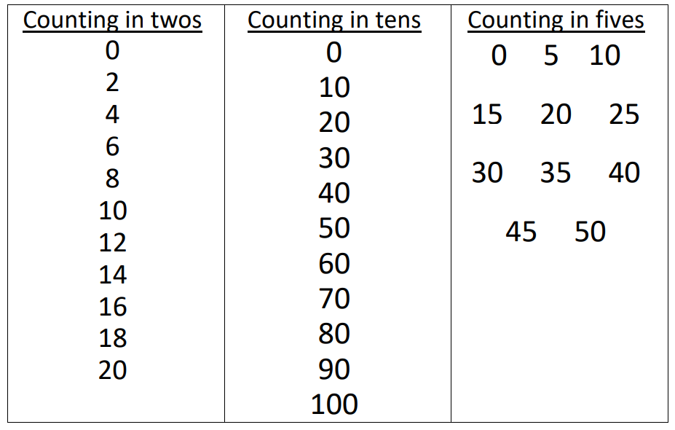
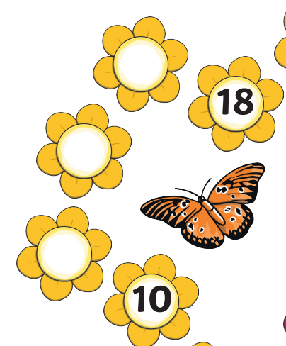
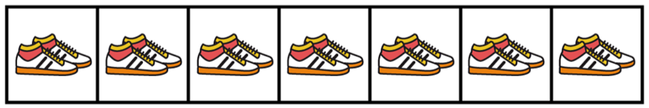
Summer Term 2 – Year 1
I can count forwards and backwards in steps of 2s, 5s and 10s.
Key vocabulary:
Children can be introduced to the ideas that these are the 2-, 5- and 10-times tables.
Activities that can be done at home:
Counting games during daily activities – count in 10s as you walk down the stairs, count in 5s as you wash your hands, count in twos when see a car
Give your child a number track and ask them to fill it counting forwards or backwards in steps of 2s, 5s or 10s.
Count pairs of shoes to see how many in total.
https://wordwall.net/en-gb/community/counting/in-2s-5s-10s

