Slide 1

Key Instant Recall Facts
What are KIRFs?
To develop your child’s fluency and mental maths skills, we are introducing KIRFs (Key Instant Recall Facts) throughout the school. KIRFs are a way of helping your child to learn - by heart - key facts and information which they need to have instant recall of.
KIRFs are designed to support the development of mental maths skills that underpin much of the maths work in our school. They are particularly useful when calculating, adding, subtracting, multiplying or dividing. KIRFs contain number facts such as number bonds and times tables that need constant practise and rehearsal so children can recall them quickly and accurately.
Instant recall of facts helps enormously with mental agility in maths lessons. When children move onto written calculations, knowing these key facts is very beneficial as it reduces the cognitive load needed, allowing the children to focus on the higher-level maths. KIRFs are not about challenging the children but making sure ALL children have key mathematical facts at their fingertips.
The secret to success is practising little and often. Can you practise these KIRFs while walking to school or during a car journey? You do not need to practise them all at once; perhaps you could have a fact of the day.

Slide 2
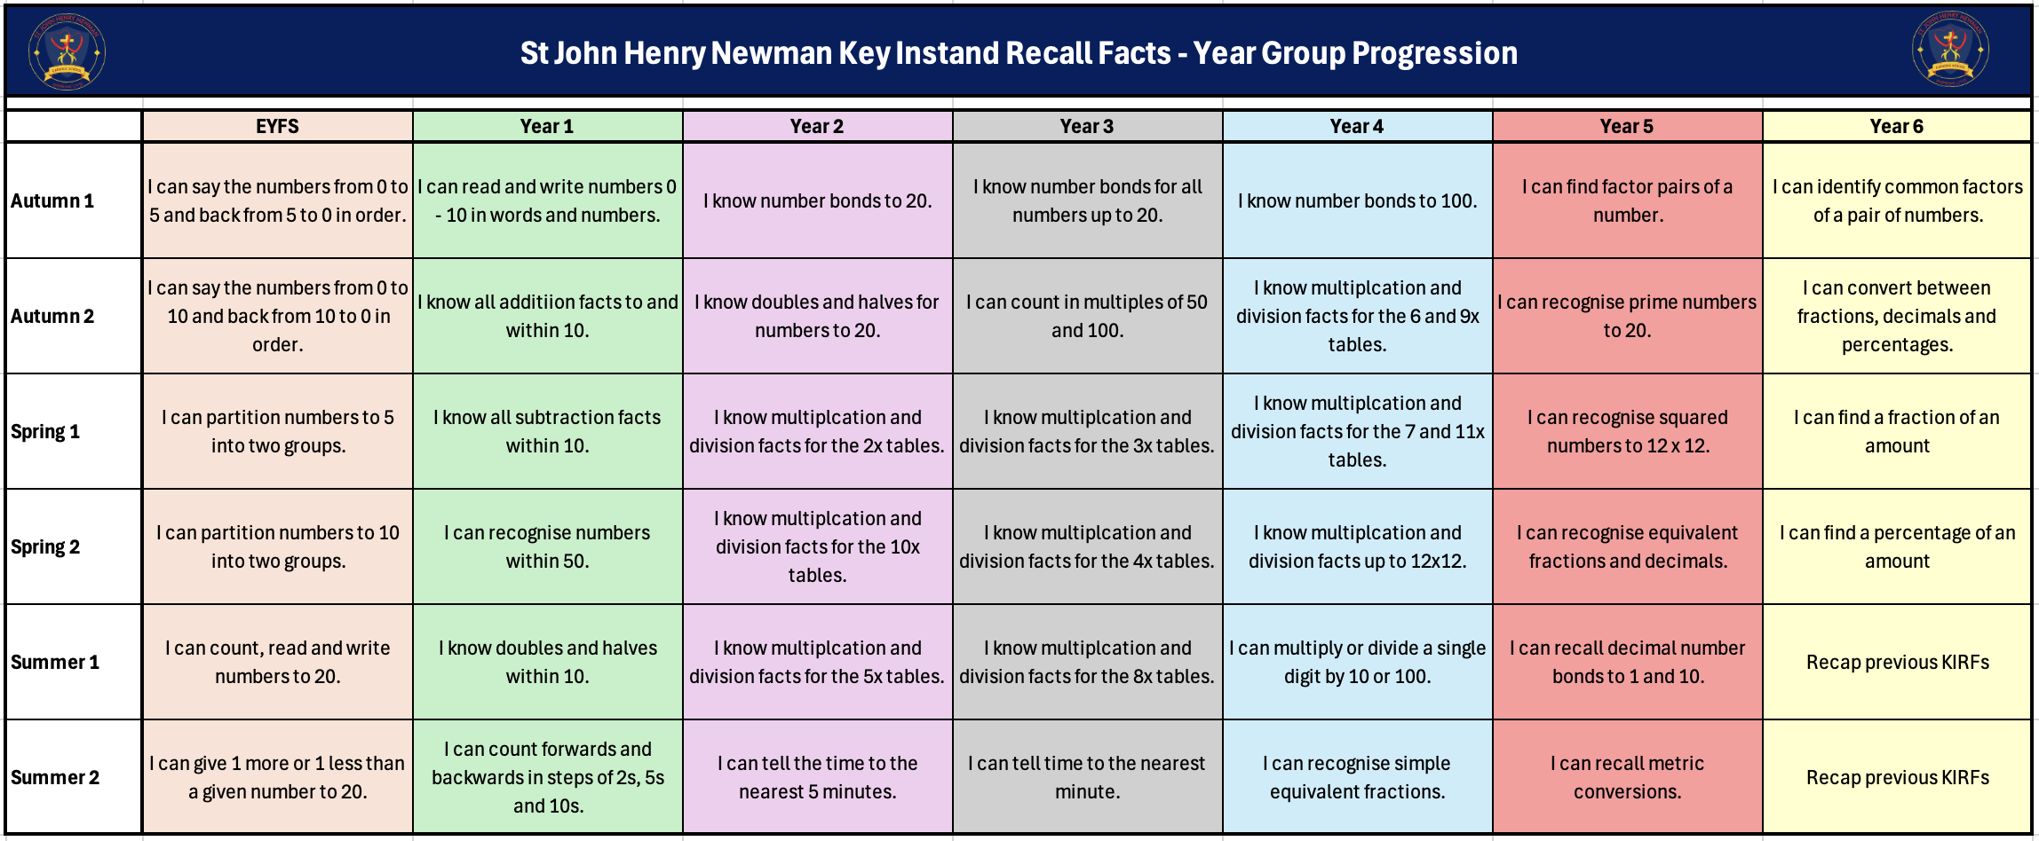
School Overview

Slide 3
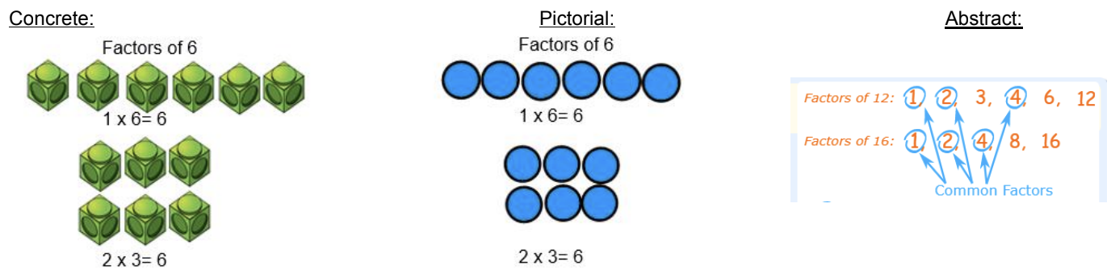
Autumn Term 1 – Year 6
I can identify common factors of a pair of numbers.
Children should be able to use their knowledge of factors to find the common factors of two numbers.
Key vocabulary:
Factor- A number that multiplies with another
to make a product (3 and 4 are factors of 12).
Common factors- A number that can be
divided into two different numbers, without
leaving a remainder (1, 2, and 4 are common factors of both 16 and 20, as both can be divided by 4 leaving a whole number).
Product- The result of multiplying one number by another.
Array- An ordered collection of counters,
cubes or other item in rows and columns.
Activities that can be done at home:
https://www.topmarks.co.uk/maths-games/multiples-and-factors
https://www.mathnook.com/math/math-speed-racing-factors.html
https://www.math-play.com/Factors-Millionaire/factors-millionaire-game_html5.html
https://www.bbc.co.uk/bitesize/topics/zfq7hyc/articles/z2w8r2p

Slide 4
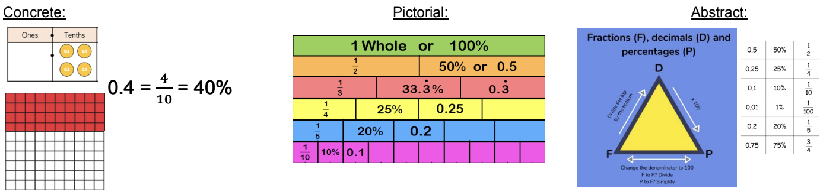


Autumn Term 2 – Year 6
I can convert between decimals, fractions and percentages.
Children should be able to convert between fractions, decimals and percentages and recall common decimal, fraction and percentage equivalences instantly.
Key vocabulary:
Convert – To change the expression without changing the size or amount.
Decimal number – a number with a decimal point.
Fraction – A fraction represents parts of a whole.
Per cent – Parts per 100. It shows the ratio “out of 100”.
Activities that can be done at home:
Dominos - write the fraction, decimal and percentage the domino is showing.
Pairs game - make your own fraction, decimal, percentage card matching game
FDP Poster - create a poster which explains how to convert between fractions, decimals and percentages
Let’s go shopping - look out for percentages when out shopping. What is 25% as a decimal?
https://www.bbc.co.uk/bitesize/topics/znjqtfr/articles/zrkw2fr#z26cjfr
$\frac{1}{3}$
=
=
33.3%

Slide 5
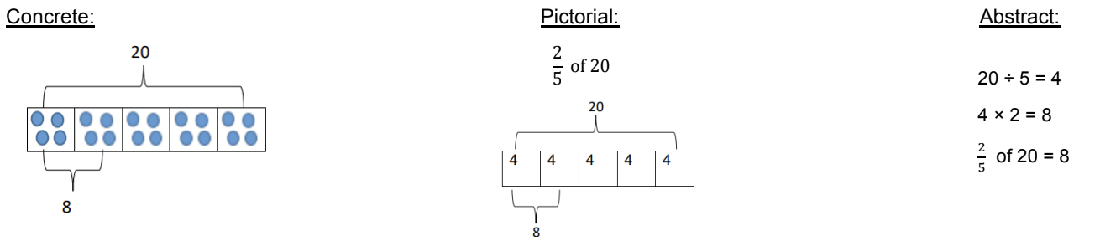
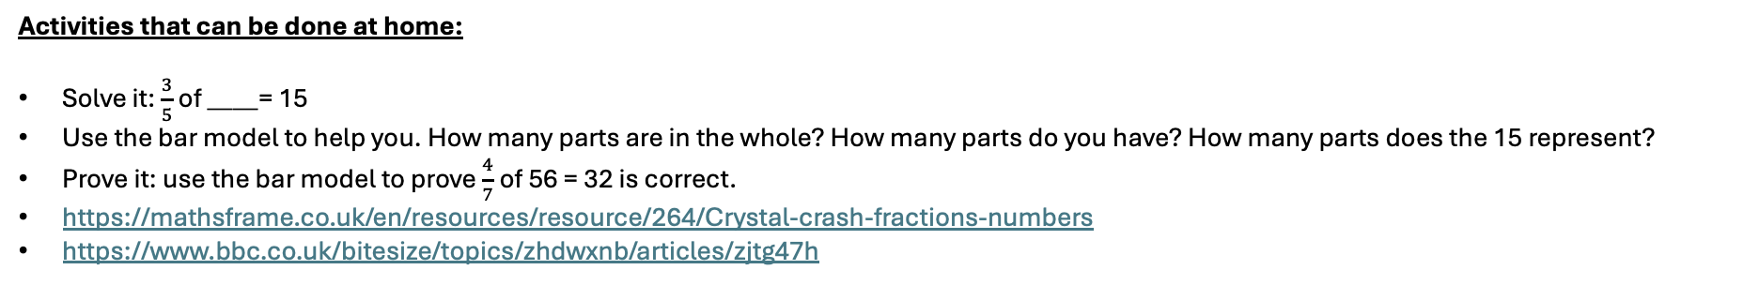
Spring Term 1 – Year 6
I can find a fraction of an amount.
Children should be able to use their knowledge of finding unit fractions of a quantity, to find non-unit fractions of a quantity.
Key vocabulary:
Numerator- The top number in a fraction.
Shows how many parts we have.
Denominator- The bottom number in a
fraction. Shows the number of equal parts in
the whole.
Unit fraction- A fraction where the numerator is one.
Non unit fraction- A fraction were the
numerator is not one.
Activities that can be done at home:
Solve it: $\frac{3}{5}$ of ____= 15
Use the bar model to help you. How many parts are in the whole? How many parts do you have? How many parts does the 15 represent?
Prove it: use the bar model to prove $\frac{4}{7}$ of 56 = 32 is correct.
https://mathsframe.co.uk/en/resources/resource/264/Crystal-crash-fractions-numbers
https://www.bbc.co.uk/bitesize/topics/zhdwxnb/articles/zjtg47h
?
5 | 5 | 5

Slide 6
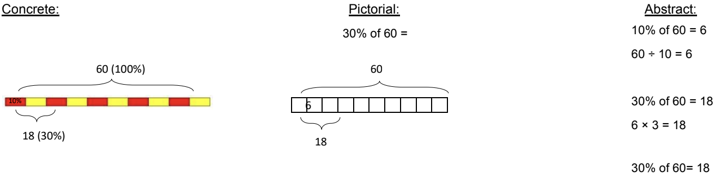
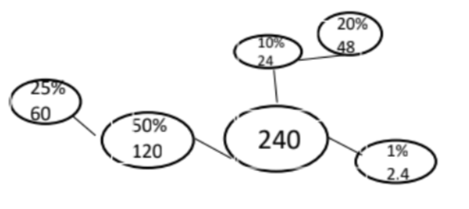
Spring Term 2 – Year 6
I can find a percentage of an amount.
Children use known fractional equivalences to find percentages of amounts. They will be able to recall how to find common percentages instantly.
Key vocabulary:
Equivalent - Have the same value.
Per cent - Parts per 100. It shows the ratio ‘out of 100’.
Activities that can be done at home:
Bargain buys - go shopping and look for offers, can you calculate the price of the item after the discount?
Benchmark percentages - the benchmark percentages are 1%, 10% and 50%. Explain How you find them. To find .....% you divide by ........
Percentage webs - create a web to show how you can use the benchmark percentages to calculate other percentage of amounts.
https://www.bbc.co.uk/bitesize/topics/znjqtfr/articles/zcfyw6f

